Slide 1
SCALARS & VECTORS
Distinguish between scalars & vectors
Give examples
Add and subtract vectors
Components of vectors

Slide 2
What is a scalar quantity?
Magnitude
Number and unit
Always positive
Follows arithmetic rules
Symbol

Slide 3
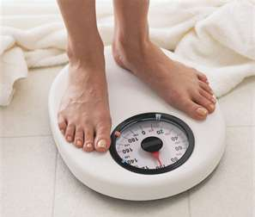
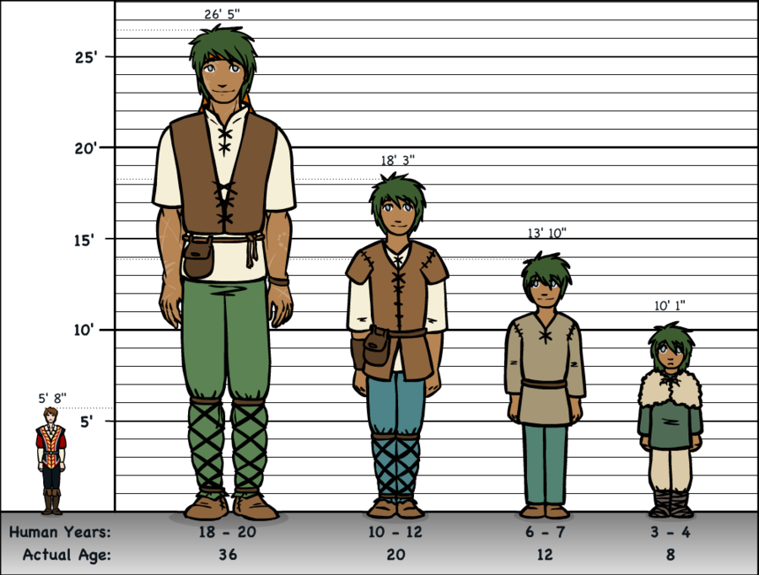
Examples of scalars
temperature
mass
height
time

Slide 4
What is a vector quantity?
Magnitude and direction
May be positive or negative
Does not follow arithmetic rules
Symbols used

Slide 5
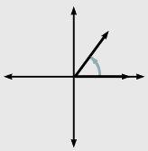
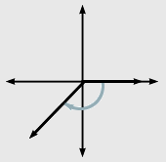
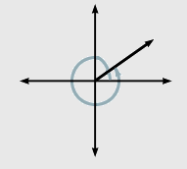
Directions
Standard Angle
Geographical Directions

Slide 6
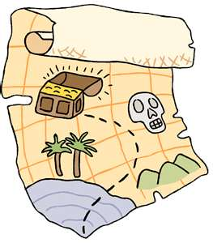
Examples of vectors
displacement
force
velocity

Slide 7
Adding and subtracting vectors
The Resultant (Net) is the result vector
that comes from adding or subtracting a
number of vectors

Slide 8
Adding and subtracting vectors
Polygon Method (Adding)
Triangle of vectors

Slide 9
Adding and subtracting vectors
Polygon Method (Adding)
Commutative Property

Slide 10
Adding and subtracting vectors
Polygon Method (Subtracting)
Negative of a vector: same magnitude, opposite direction

Slide 11
Adding and subtracting vectors
Polygon Method (Adding)

Slide 12
Adding and subtracting vectors
Analytical Method: Cosine Law

Slide 13
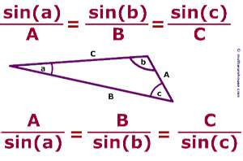
Adding and subtracting vectors
Analytical Method: Sine Law

Slide 14
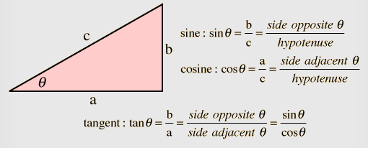
Adding and subtracting vectors
Components Method

Slide 15
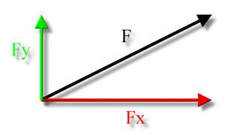
Adding and subtracting vectors
Components of a Vector

