Slide 1
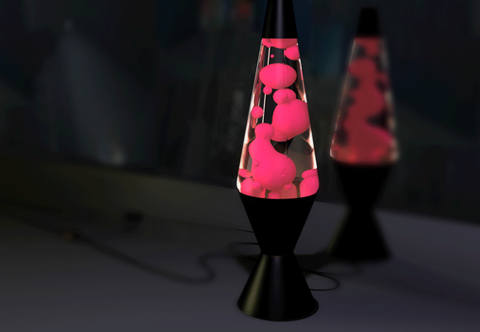
Density
Definition and Equation
Examples
Methods of Determining Density
Exercises

Slide 2
Definition and Equation
mass
M
density =
D =
volume
V
Density is the mass per unit volume of an substance or material.
SI Units
kg m⁻³
g cm⁻³
Density in g cm⁻³ x 1000 →kg m⁻³
M
D
V

Slide 3
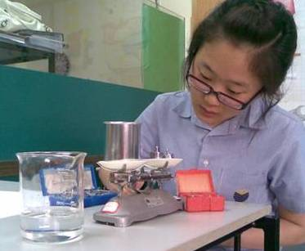
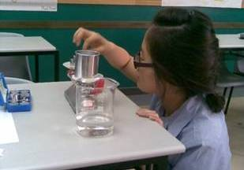
Method 1: Regularly-shaped Object
1. Measure mass using a balance.

Slide 4
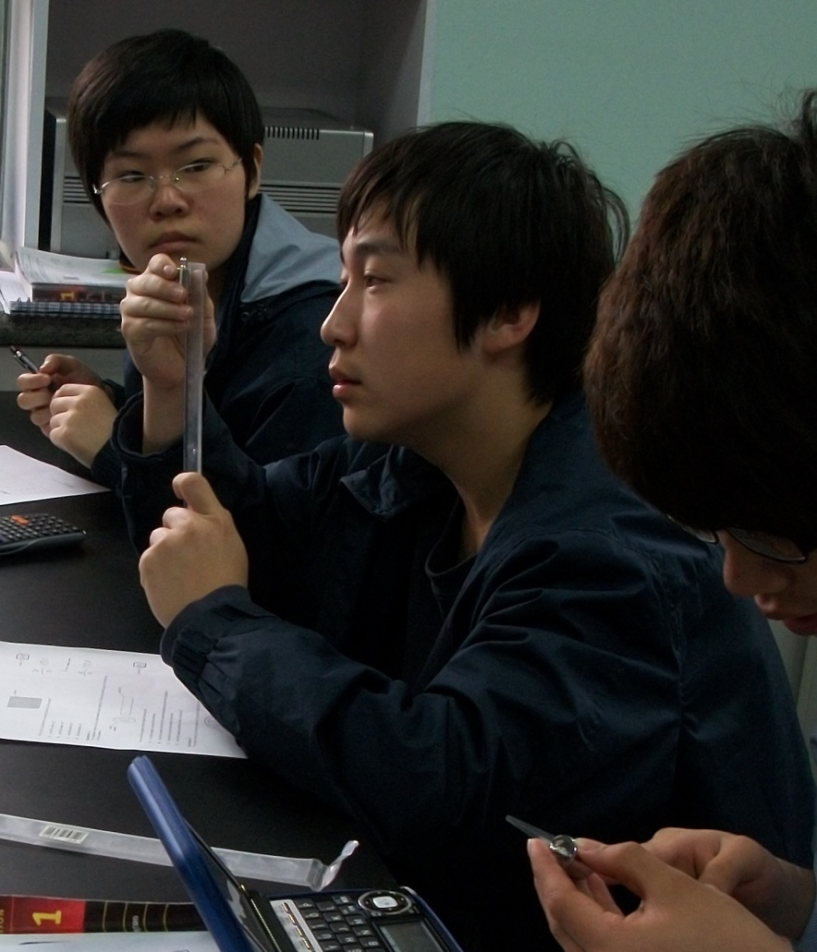
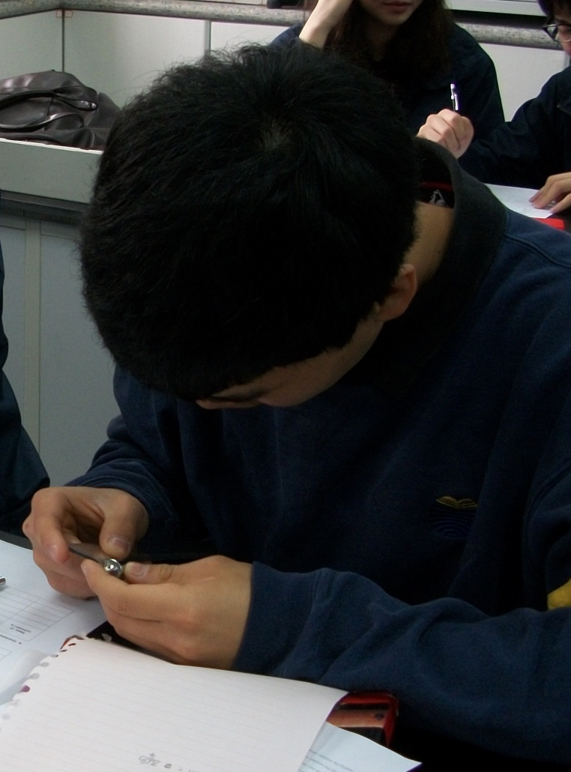
Method 1: Regularly-shaped Object
2. Measure the dimensions necessary to find the volume and then calculate the volume.

Slide 5
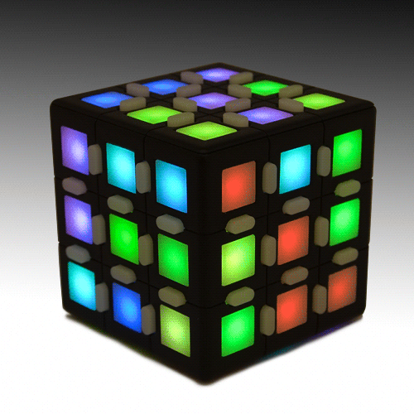
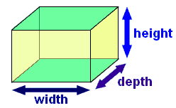
Formulas for Volume of Regularly-shaped Object
Volume of a cuboid
= w x d x h
= A x width
Volume of cube = s³

Slide 6
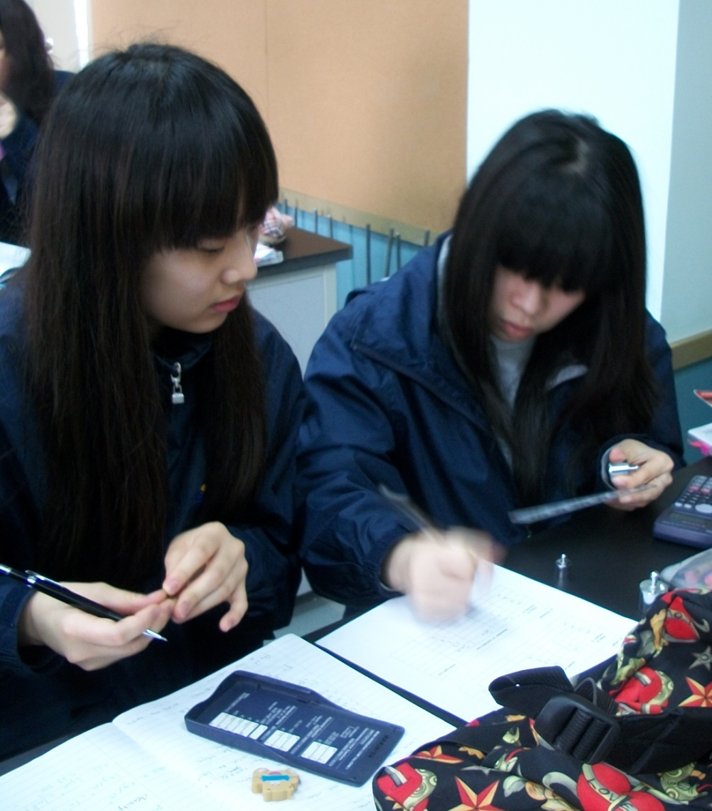
Method 1: Regularly-shaped Object
3. Determine the density by dividing the mass by the calculated volume.

Slide 7
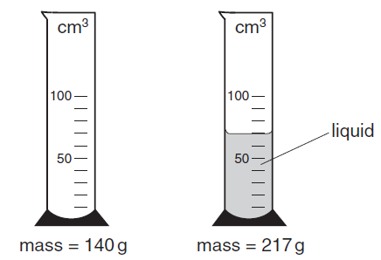
Example 1

Slide 8
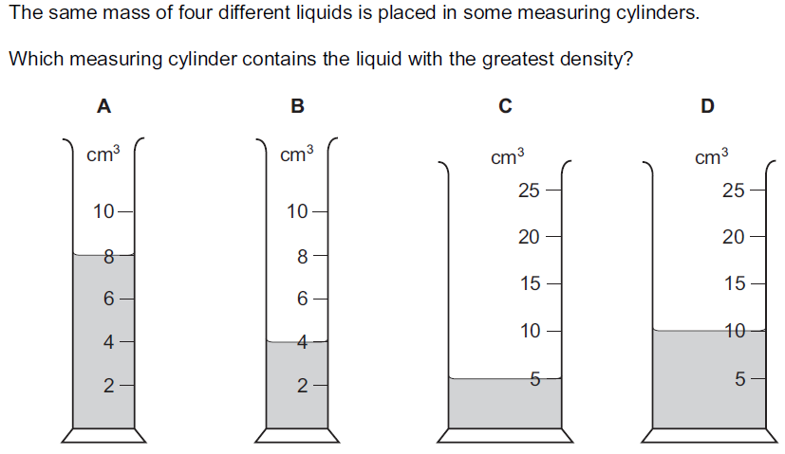
Example 2

Slide 9
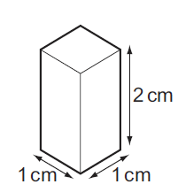
Example 3
The wooden block as shown has a mass of 1.50 g. What is the density of this wood?

Slide 10
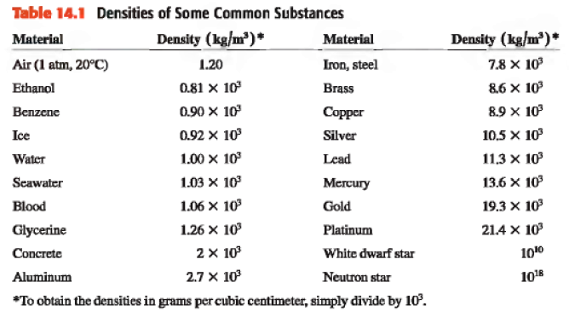

Slide 11
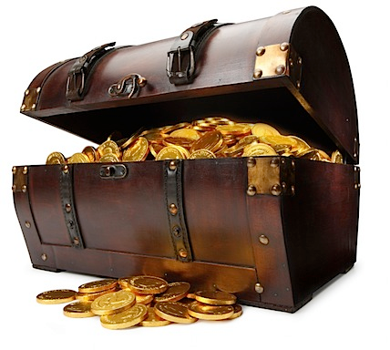
Density and the Movies

