Slide 1
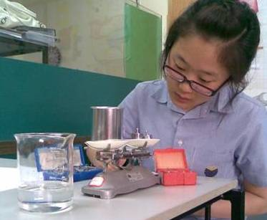
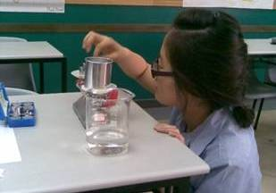
Method 2: Irregularly-shaped Object
1. Measure mass using a balance.

Slide 2
Method 2: Irregularly-shaped Object
2. Pour water in a measuring cylinder and record its initial volume.
3. Completely submerge the object into the water and record the final volume.
4. The volume of the object is then determined by getting the difference between the final and initial volumes.

Slide 3
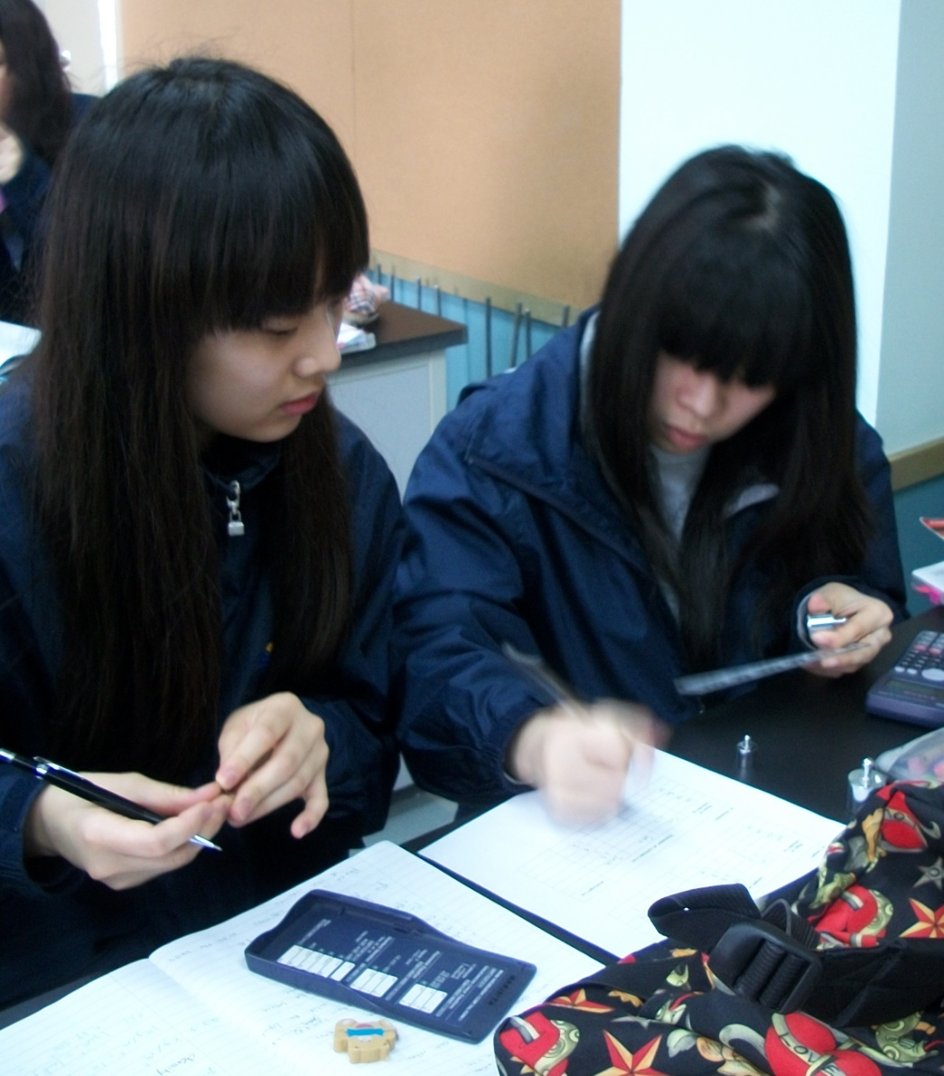
Method 1: Regularly-shaped Object
5. Determine the density by dividing the mass by the calculated volume.

Slide 4
Density and Us
Helps determine what a material is made of
Helps determine if an object will float on a fluid or not
Density of object < density of the fluid
The object will float on the fluid
Density of object = density of fluid
The object will be floating in the fluid
Density of object > density of fluid
The object will sink

Slide 5
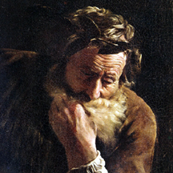
Density and Archimedes

Slide 6
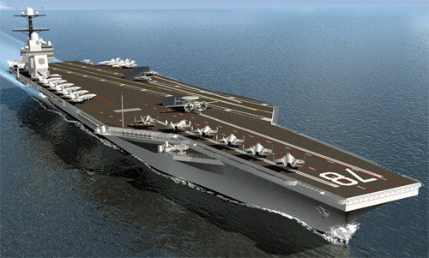
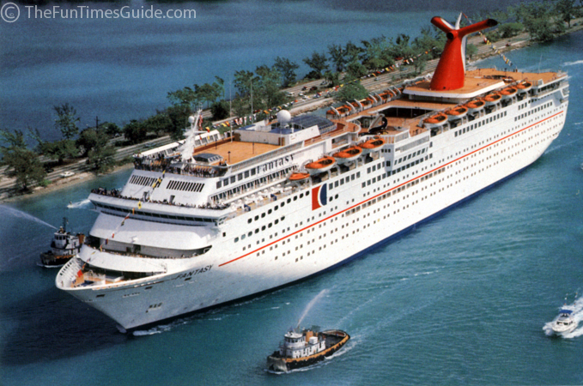
Density and Us

Slide 7
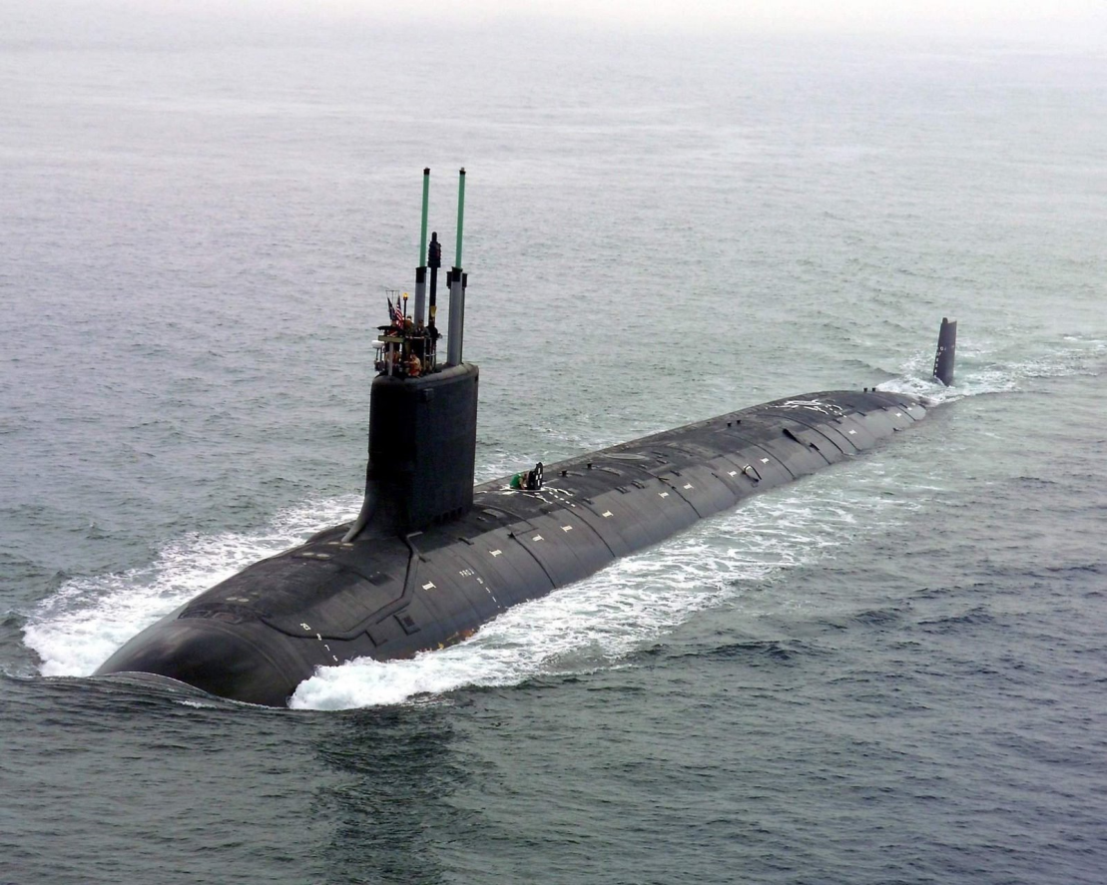
Density and Us

