Slide 1
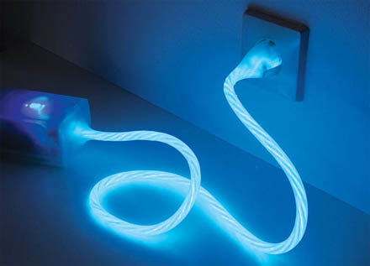
Electrical Quantities
Electrical Current
Electrical Circuits
Potential Difference
Meters

Slide 2
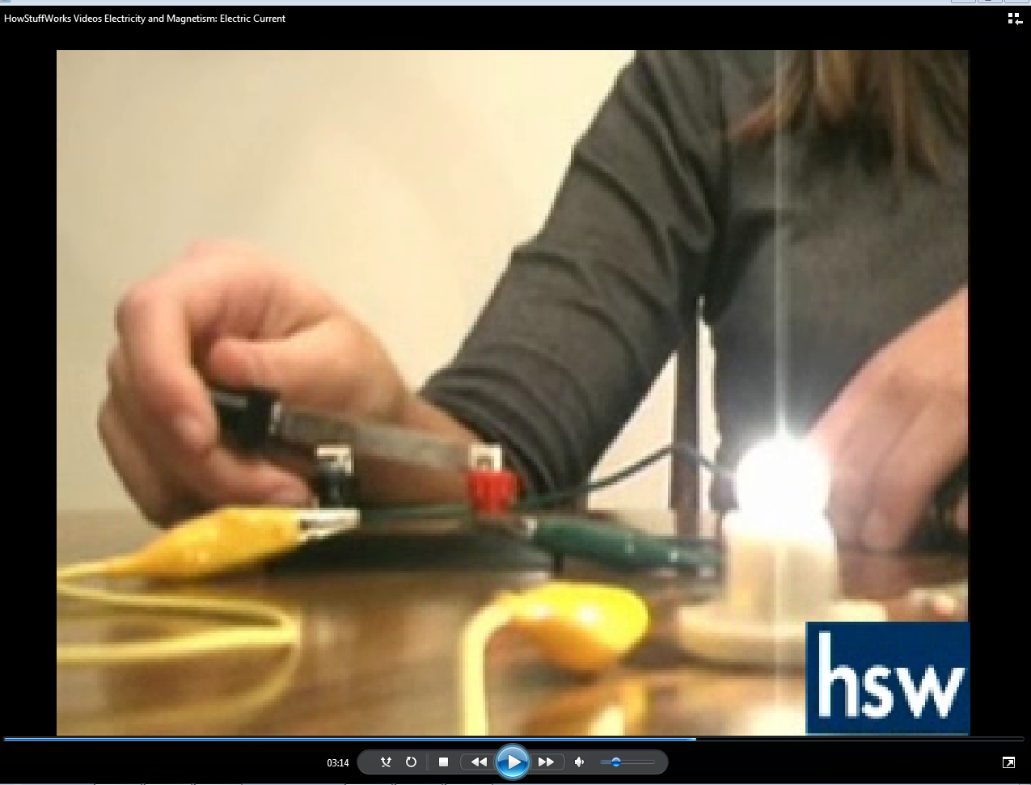
Video on Electric Current Questions
What is current?
What unit is used for current?
What are the two types of current?
What is a circuit?
What components are necessary to make a complete circuit?

Slide 3
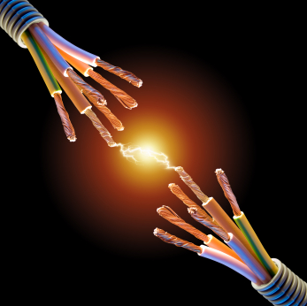
Current
Rate of flow of charge
Amount of charge flowing per unit time
Equation
Current =
I =
Measured in amperes, A
Amount of charge
Time taken
Q
t

Slide 4
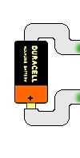
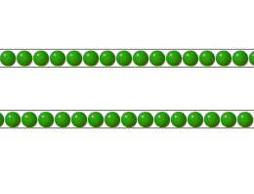
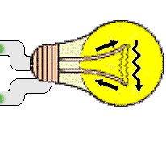
Types of Current
Direct current
Flow of charge is in one direction

Slide 5
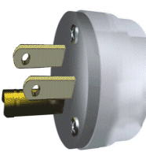
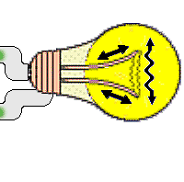
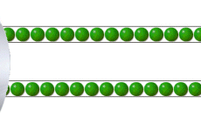
Types of Current
Alternating Current
Flow of current changes or reverses in direction

Slide 6
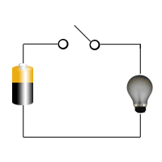
Circuit and Symbols
A path where electrons can flow
Three important parts
Source of energy
Battery
Outlet
Conducting Path
Electrical wires
Resistor
lamp

Slide 7
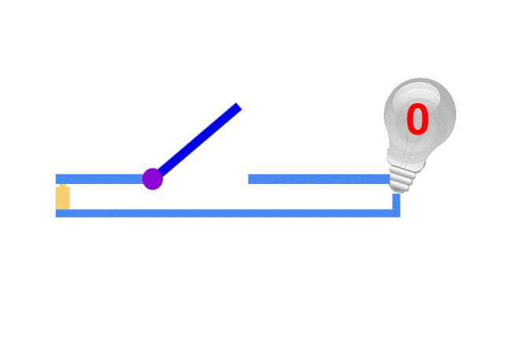
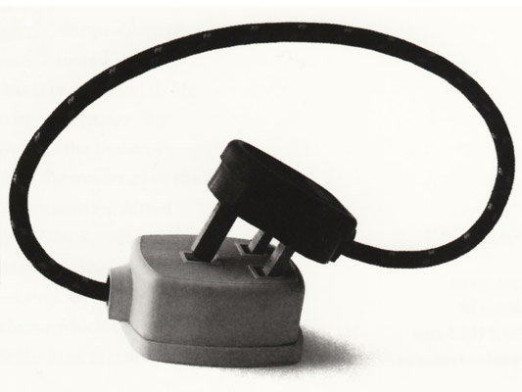
More on Circuits
Closed circuit
Complete path
Open circuit
There is a break in the conducting path
Open switch
Broken wire
Busted bulb
Short circuit
No resistor in the circuit
Very high current

Slide 8
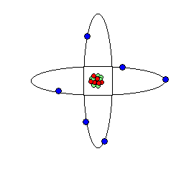
Question
How fast do electrons move?
(You pushed the switch button and the light turns on in a short amount of time.)

Slide 9
Answer: 1 cms⁻¹!

Slide 10
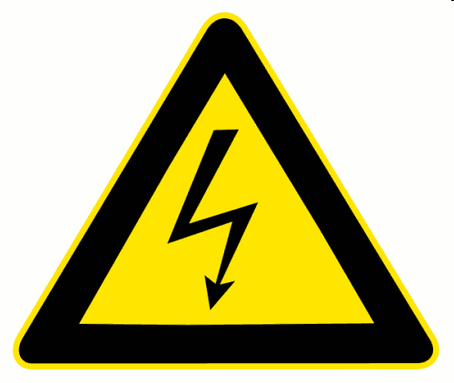
Voltage
Energy per unit of charge
Equation
Voltage =
Unit: Volt, V
“driving force” that pushes charges around the circuit
Two basic types
emf (electromotive force)
pd (potential difference)!!!
Energy
Charge

Slide 11
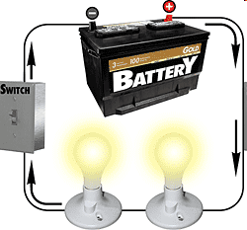
Question
What happens to the electrical energy supplied in the circuit?

Slide 12
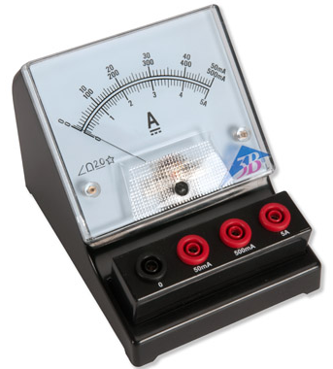
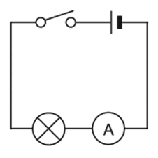
Measuring Current: Ammeter
Connected in series with the component
Break and connect

Slide 13
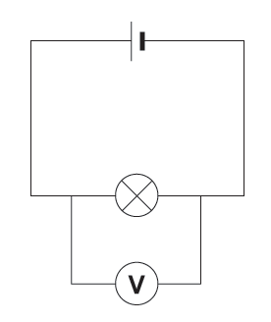
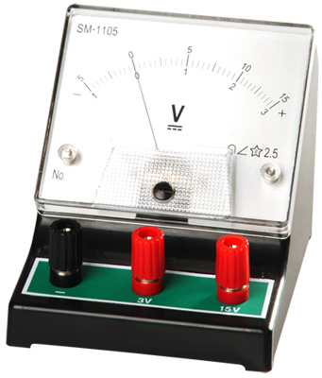
Measuring Voltage: Voltmeter
Connected parallel to the component

