Slide 1
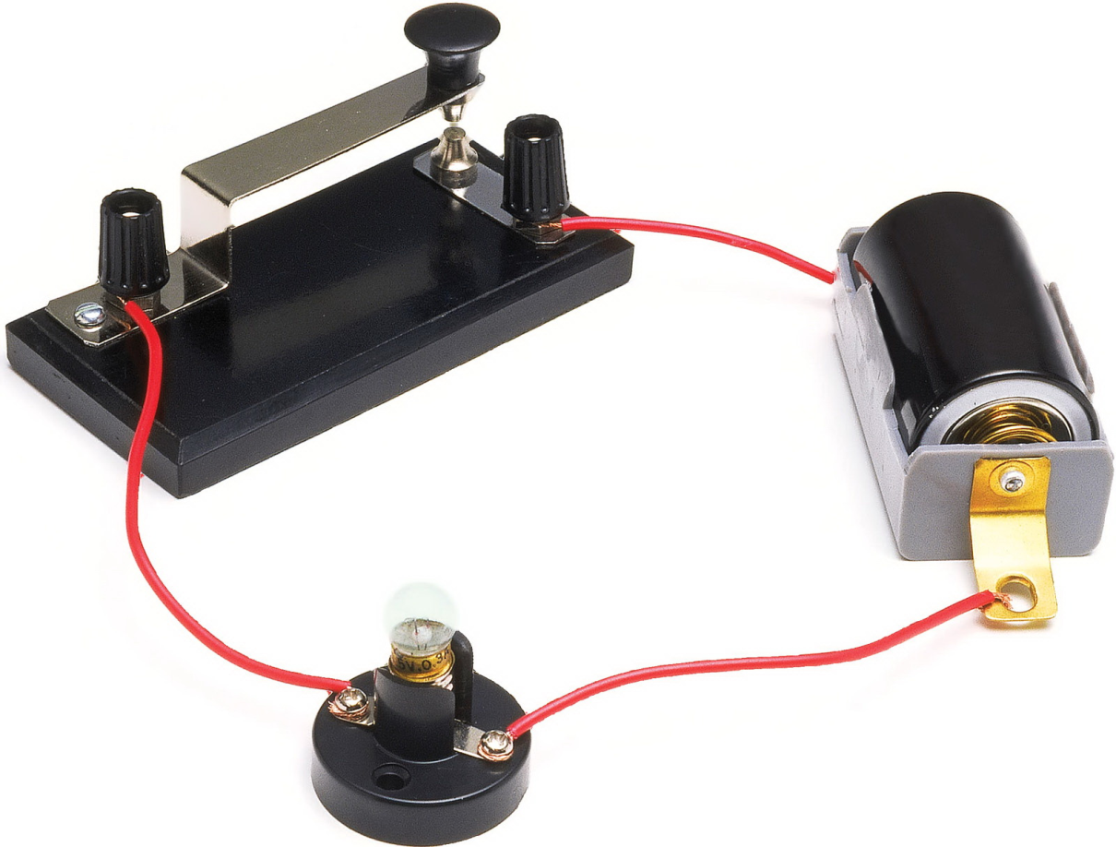
Series and parallel circuits
After experiment and with simulation

Slide 2
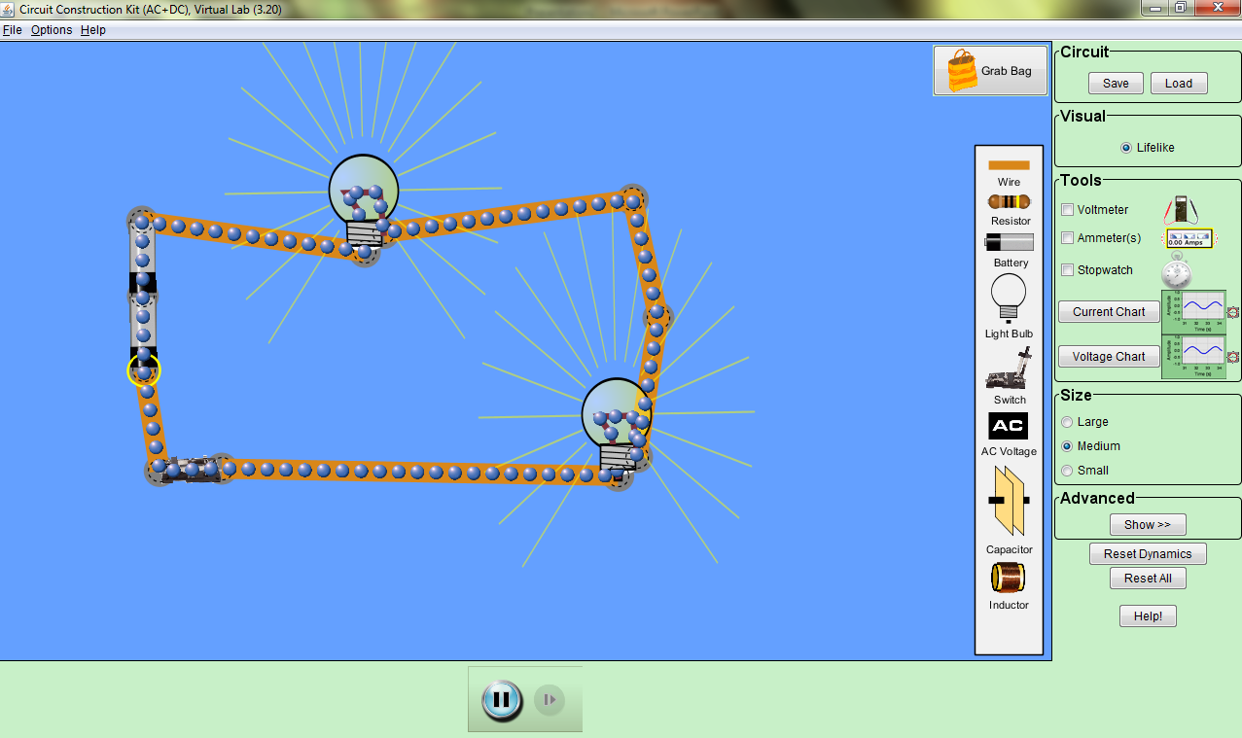
Simulation

Slide 3
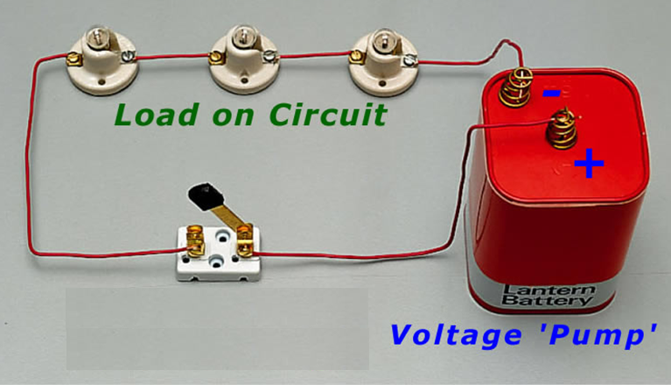
Series Circuit

Slide 4
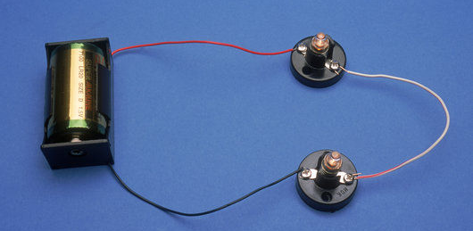
Series Circuit
There is one complete path for electrons to flow
The current in each element in the circuit is the same
The sum of the pd across each resistor is equal to the voltage supply

Slide 5
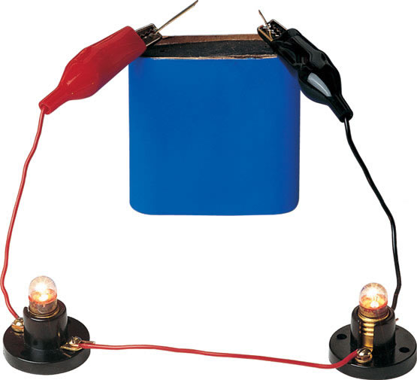
Series Circuit
I_{total} = I₁ = I₂ = I_{n}
V_{total} = V₁ + V₂ + V_{n}

Slide 6
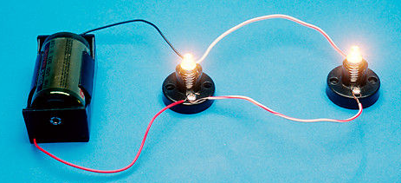
Parallel Circuit

Slide 7
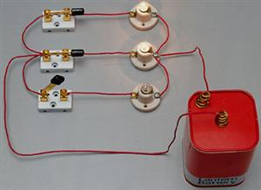
Parallel Circuit
There is more than one complete path for electrons to flow
The pd across each element in the circuit is the same
The sum of the current in each resistor is equal to the supplied current

Slide 8
Parallel Circuit
V_{total} = V₁ = V₂ = V_{n}
I_{total} = I₁ + I₂ + I_{n}

