Slide 1
Forces
Seeing forces
Forces big and small
Weight – the pull of gravity
Friction – an important force
Air resistance
Patterns of falling
End of Unit questions

Slide 2
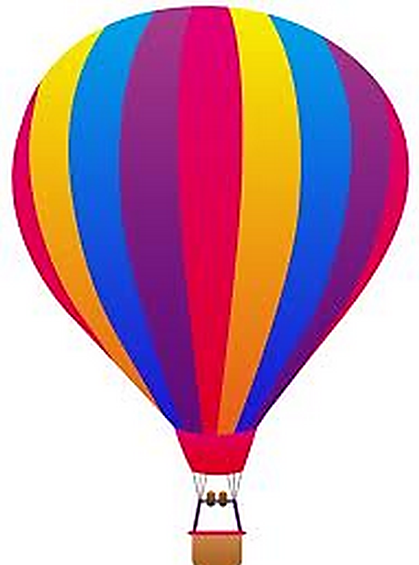
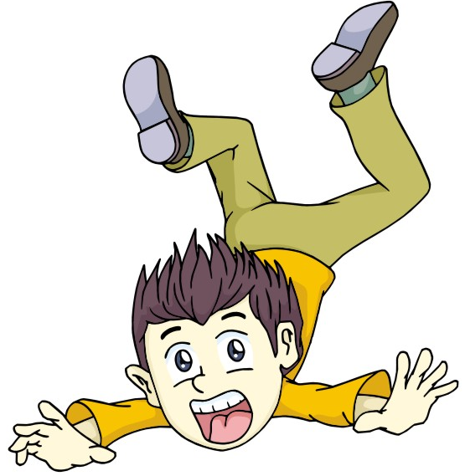
Air resistance
Falling through the air
Weight
Weight
Weight
Air resistance
Air resistance
Contact Force
Moves down fast
Moves down slowly

Slide 3
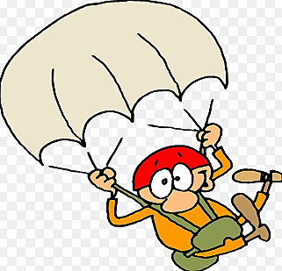
Weight
Weight
balanced
Air resistance
Moves at steady speed

Slide 4
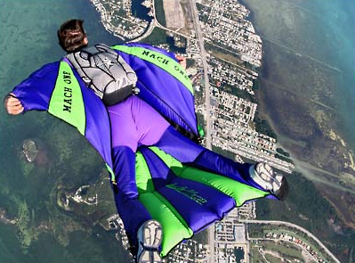
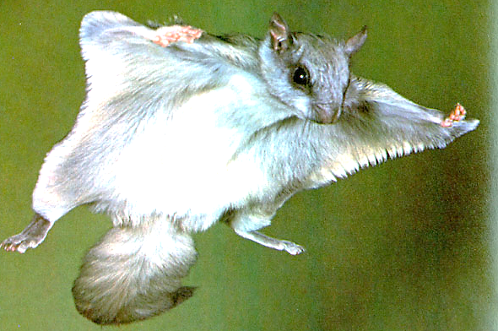
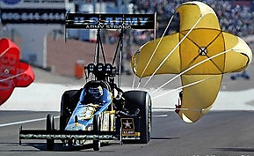
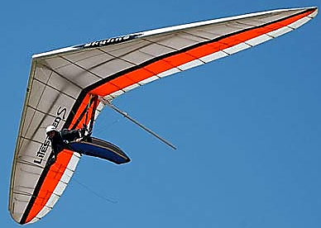
Using air resistance
Flying squirrel
Skydiver
Race
Glider

Slide 5
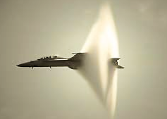
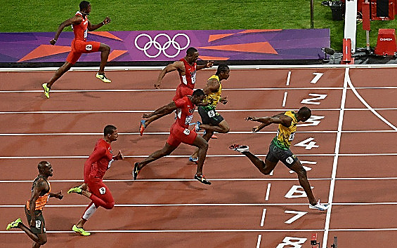
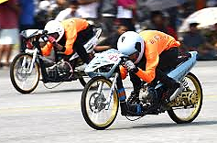
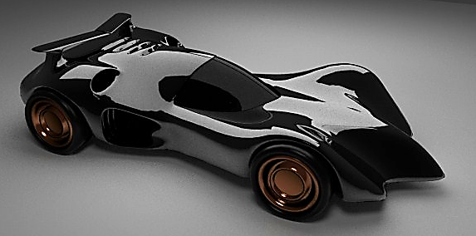
Avoids air resistance
marathon
Aircraft
Race
Car

Slide 6
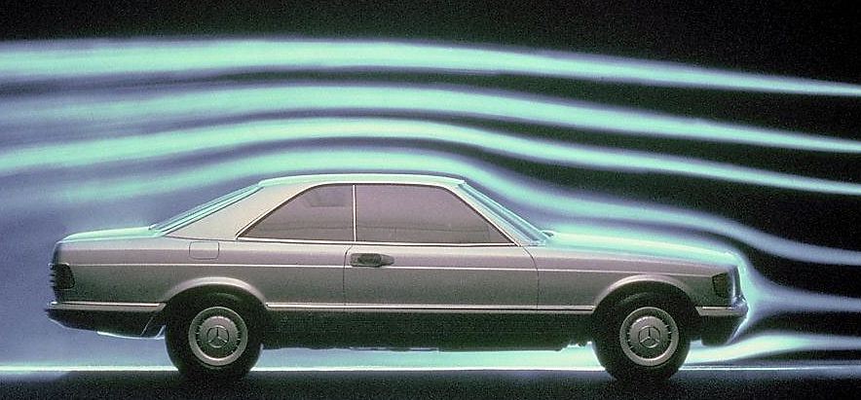
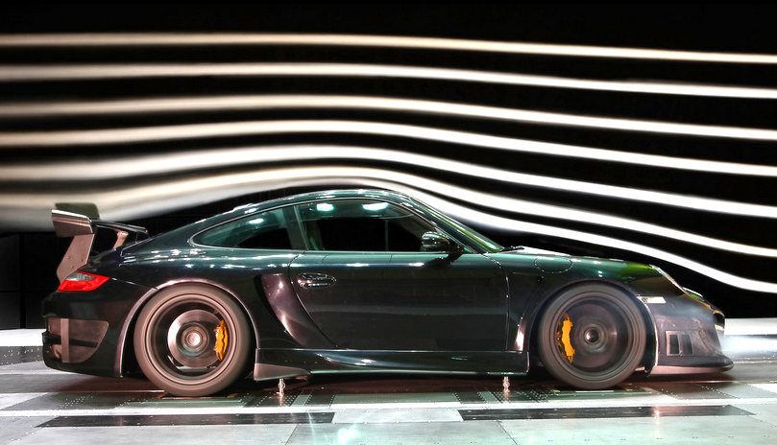
Move easily through the air
air resistance and friction
streamlined

Slide 7
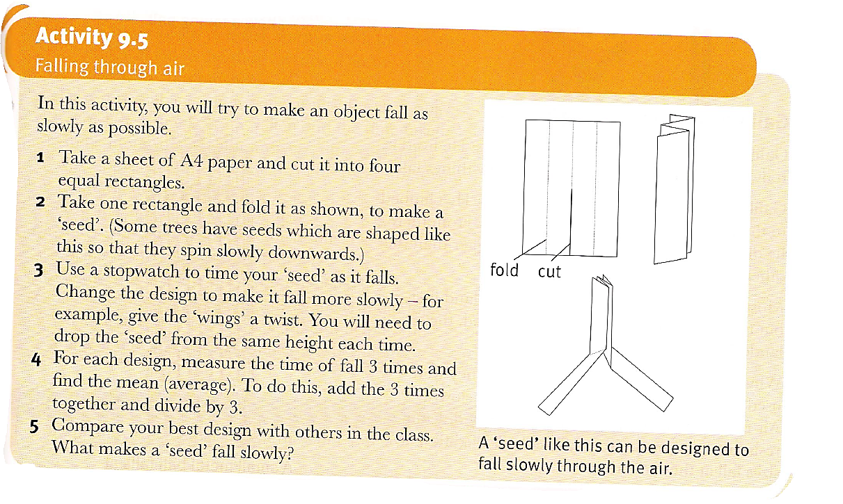

Slide 8
Review: True or False
1. When an object is falling in the air, air resistance is acting on it.
2. Air resistance is opposite to the direction of motion.
3. When forces on an object are not equal, we say that the forces are balanced.
4. Air resistance slows down anything that is moving.

Slide 9
Review: True or False
5. An object that is streamlined cannot move easily in the air.
6. A parachutist has weight and air resistance acting on him.
7. The bigger the area of the object, the bigger is the air resistance on it.
8. Air resistance is not useful.

