Slide 1
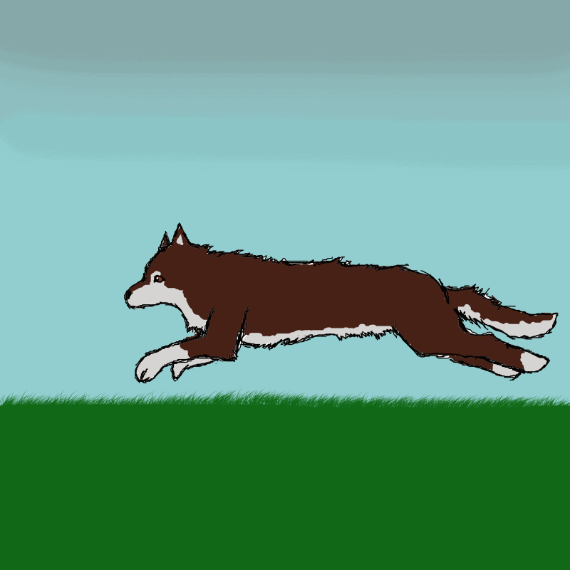
Describing Motion
Speed
Acceleration
Graphs

Slide 2
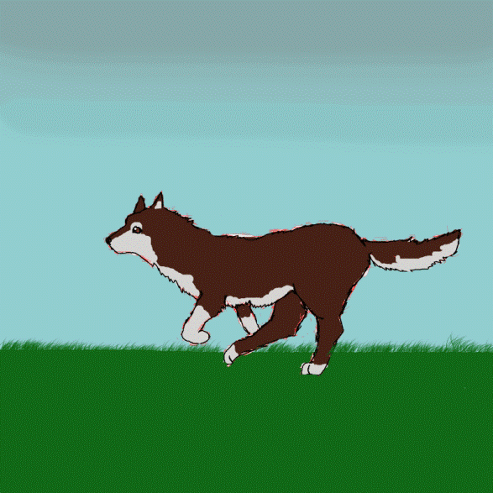
What quantities are necessary when describing motion?
Distance traveled
Time taken

Slide 3
Speed
Distance moved per unit time
Units: ms⁻¹, kph, cms⁻¹
Speed =
distance moved
time taken

Slide 4
Examples
s
v =
t
page 15 #3
page 16 #6, #7

Slide 5
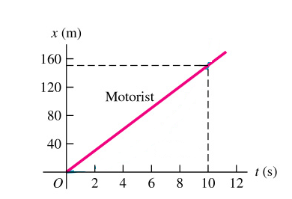
Graphs: Distance versus time
The slope of the graph tells us the speed of the object.

Slide 6
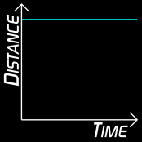
Graphs: Distance versus time
The slope of the graph tells us that the object is not moving.

Slide 7
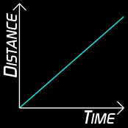
Graphs: Distance versus time
The slope of the graph tells us that the object is moving at constant speed.

Slide 8
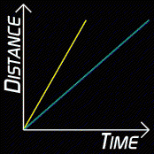
Graphs: Distance versus time
The slopes of each graph tell us that the yellow object is moving faster than the blue object.

Slide 9
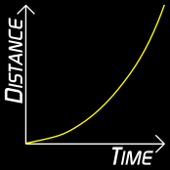
Graphs: Distance versus time
The slopes of each tangent line on the graph tell us that the object is moving faster.

Slide 10
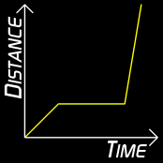
Graphs: Distance versus time
Moved at constant speed
Stopped
Moved faster at a constant speed

Slide 11
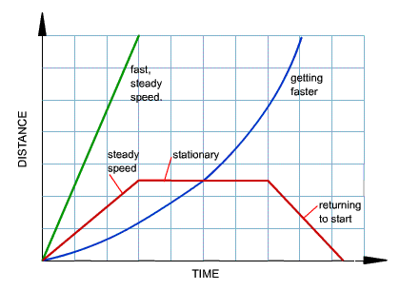
Graphs: Distance versus time

Slide 12
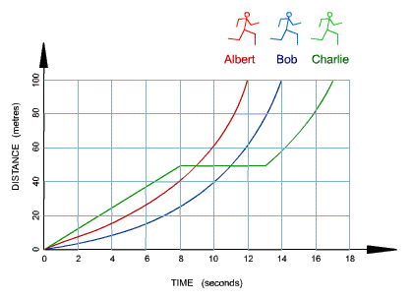
Example
Who won the race?
Who stopped for a rest?
How long did he stop for?

Slide 13
Example
How long did Bob take to complete the race?
Calculate Albert's average speed.

Slide 14
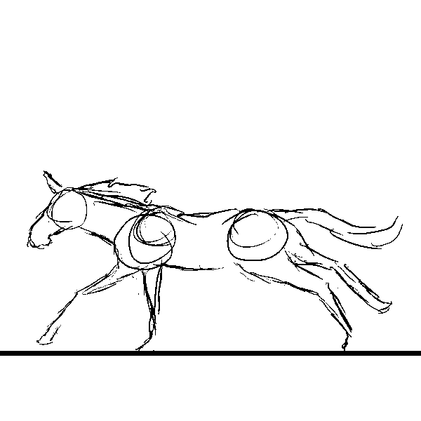
Acceleration
Change in speed per unit time
Units: ms⁻²
a =
v_{f} – v_{i}
t
Acceleration =
Final speed – initial speed
time taken

Slide 15
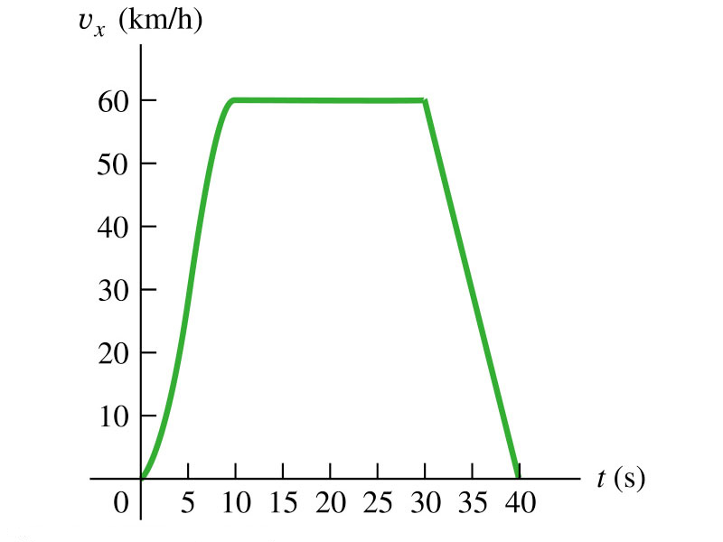
Graphs: Speed versus time
The slope of the graph tells us the acceleration of the object.
The area under the graph tells us the distance traveled by the object.

Slide 16
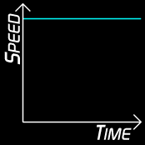
Graphs: Speed versus time
The object is moving at constant speed.

Slide 17
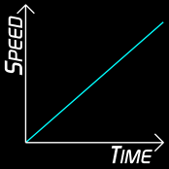
Graphs: Speed versus time
The object is moving at increasing speed.
The acceleration is constant.

Slide 18
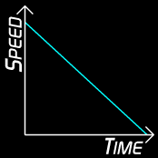
Graphs: Speed versus time
The object is moving at decreasing speed.
The deceleration is constant.

Slide 19
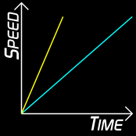
Graphs: Speed versus time
Both objects reach the same maximum speed.
Yellow shows greater acceleration than blue.

Slide 20
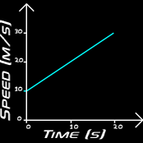
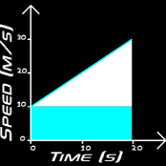
Graphs: Speed versus time
What is the acceleration of this object?
How far has it traveled in 20 s?

Slide 21
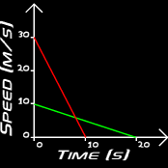
Graphs: Speed versus time
What is the acceleration of each object?
Which has traveled a greater distance?

Slide 22
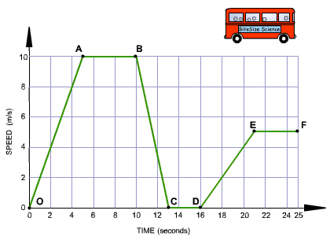
Speed and Acceleration
On which part of the journey is the bus
accelerating?
decelerating?
steady speed?
stationary?

Slide 23
Speed-time graph and acceleration
During which part of the journey was the bus moving fastest?
During which part of the journey did the bus have greatest acceleration?
Calculate the acceleration between D and E.

