Slide 1
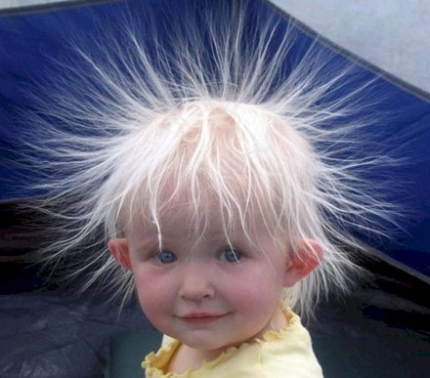
Electric Charge

Slide 2
Topics
Production and detection of charges
Positive and negative charges
Law of attraction and repulsion
Electric field
Conductors and Insulators

Slide 3
Greeks and Amber

Slide 4
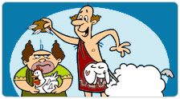
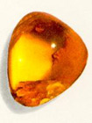
Greeks and Amber
Rubbing amber with wool causes it to attract lighter things

Slide 5
For the Greeks it was pure awesomeness!
Today, it is just all about electric charge.

Slide 6
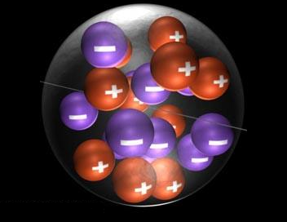
Types of Charge
Positive charge
Negative charge

Slide 7
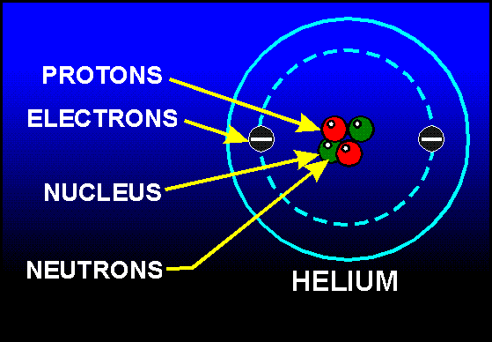
The Atom

Slide 8
Charges and Particles
Proton has positive charge
Electron has negative charge
Amount of charge on electron = amount of charge on proton
Amount of charge = ±e

Slide 9
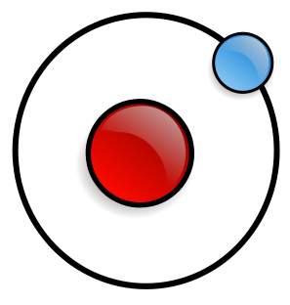
The smallest charge is an electron (or a proton.)

Slide 10
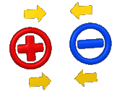
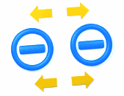
Attraction and Repulsion
Unlike charges attract
Like charges repel

Slide 11
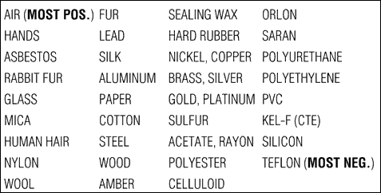
The Triboelectric Series

Slide 12
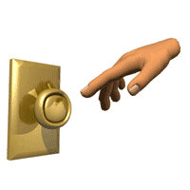
The attraction and repulsion are non-contact forces.
How can this force be applied without contact?

Slide 13
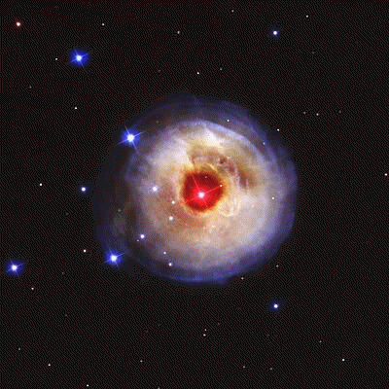
The Electric Field
Region of space around a charge where a positive point charge can experience a force

Slide 14
The Electric Field

Slide 15
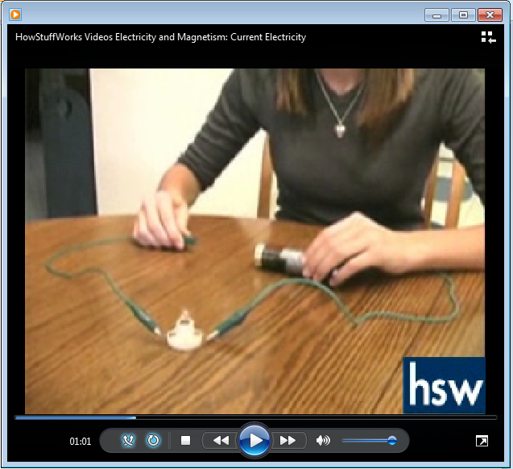
Materials & Electric Charges

Slide 16
Conductors
Materials that allow charges to flow through it
Examples
Metals
Impure water

Slide 17
Insulators
Materials that inhibit the flow charges
Examples
Plastics
Rubber
Wood

Slide 18
The Van de Graaff Generator

