Slide 1
Forces
Seeing forces
Forces big and small
Weight – the pull of gravity
Friction – an important force
Air resistance
Patterns of falling
End of Unit questions

Slide 2
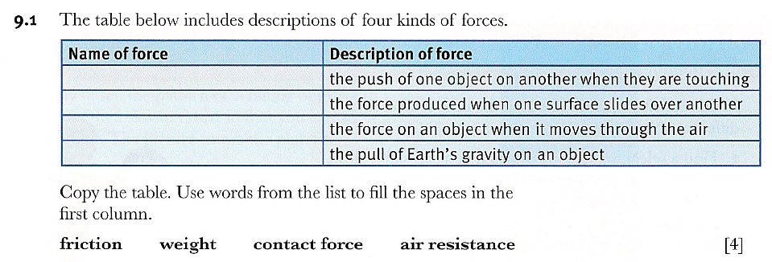
End of Unit Questions

Slide 3
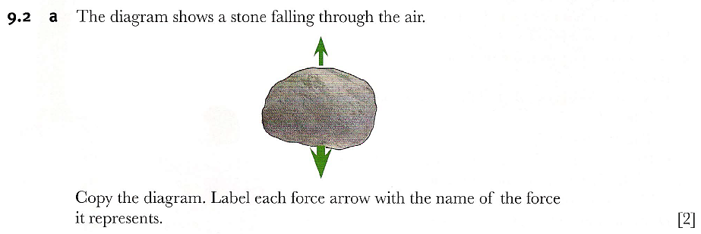

Slide 4
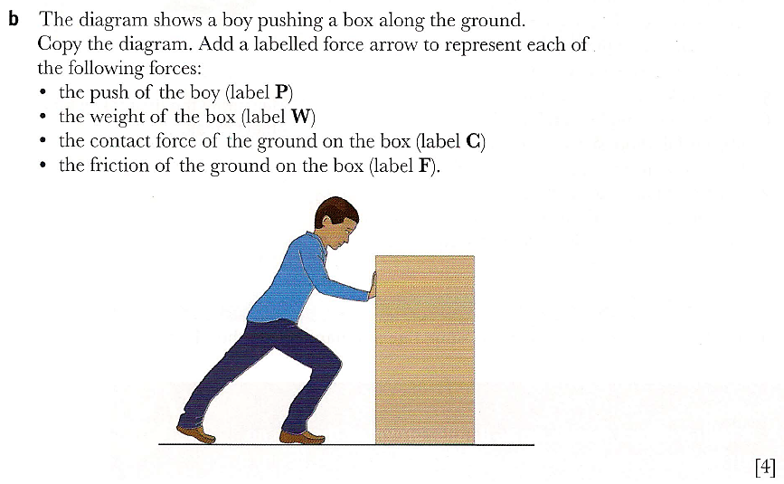

Slide 5
