Slide 1
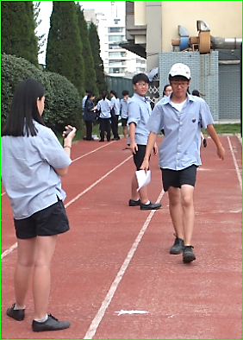
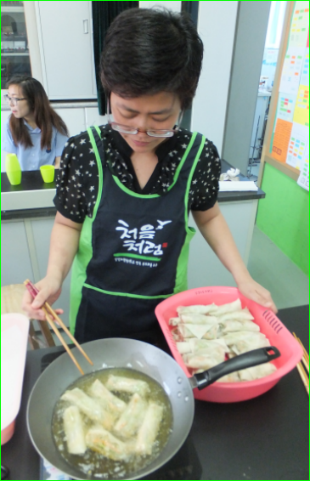
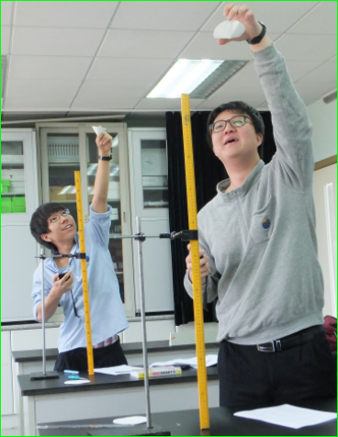
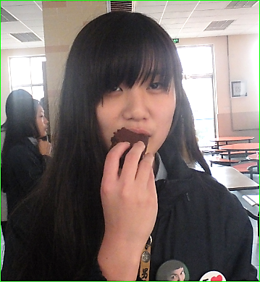
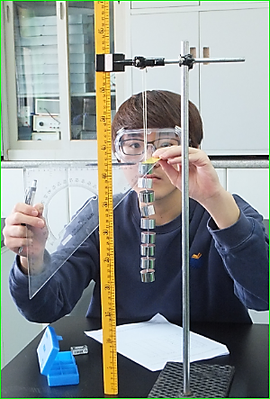
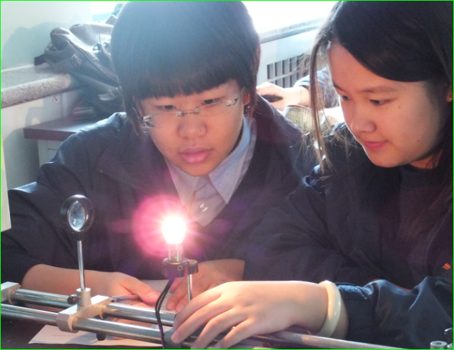
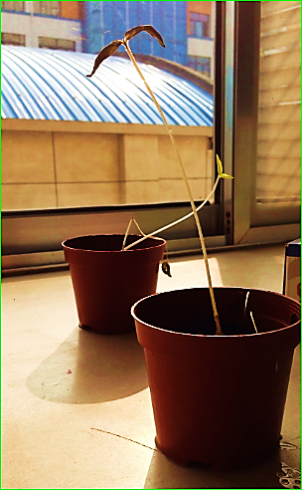
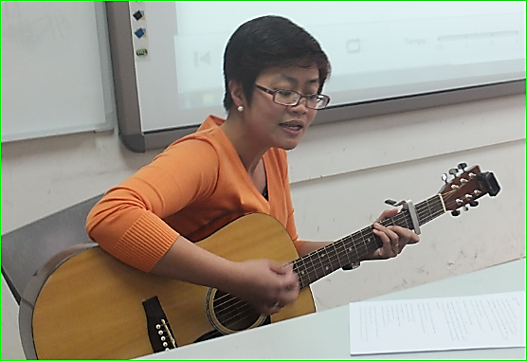
Energy Everywhere
Noah and Harry are giving potential energy to the paper cones.
Rocky is showing kinetic energy by walking.
Teacher Maridith is using thermal energy to cook yummy spring rolls.
Finding forms of energy in class activities
May and Laura are using light energy from the bulb to understand lenses.
Ameily is eating brownies for chemical energy.
Jack is giving strain energy to the rubber band.
Teacher Maridith is using sound energy to hurt the students’ ears.
Grade 6 students producing electrical energy from dry cells.
Students using light energy from the sun to study the behavior of plants.

