Slide 1
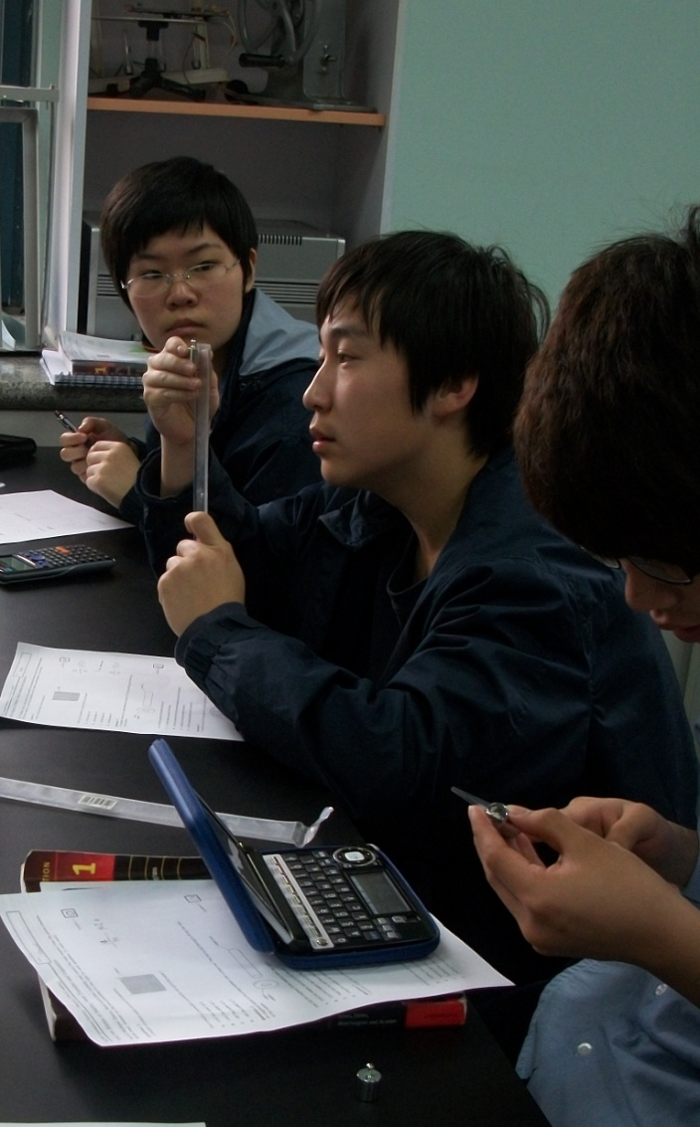
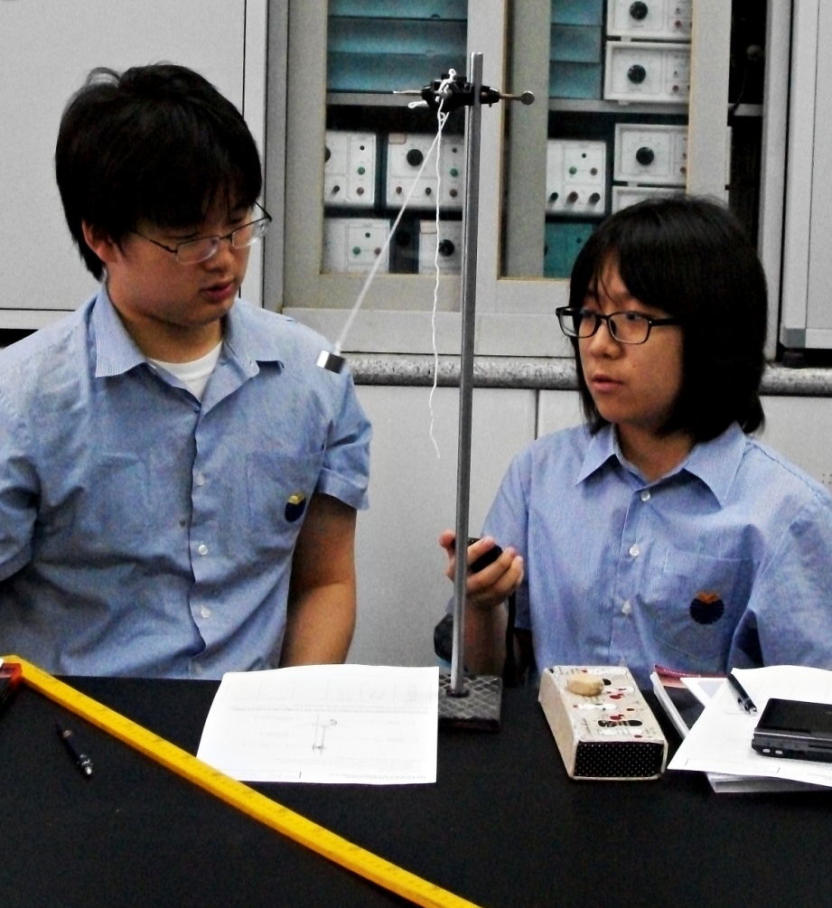
Making Measurements

Slide 2
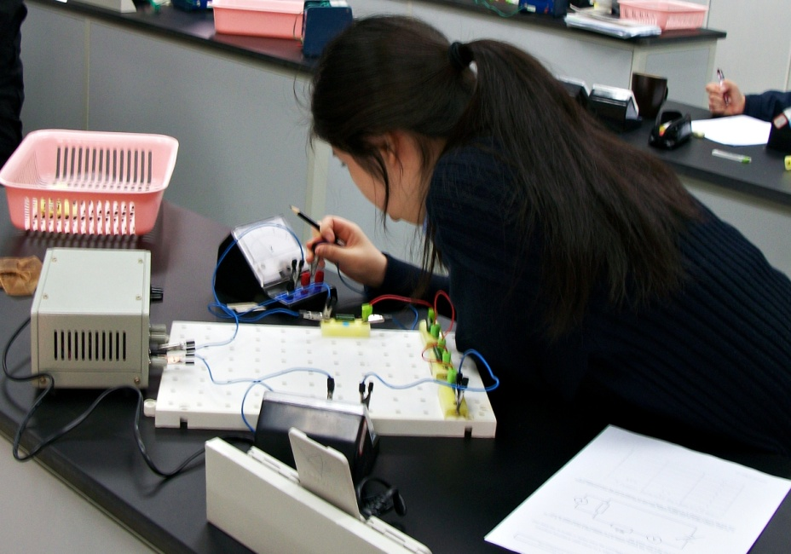
Measurement
You are making a measurement when you
Check you weight
Read your watch
Take your temperature
Weigh a cantaloupe
What kinds of measurements did you make today?

Slide 3
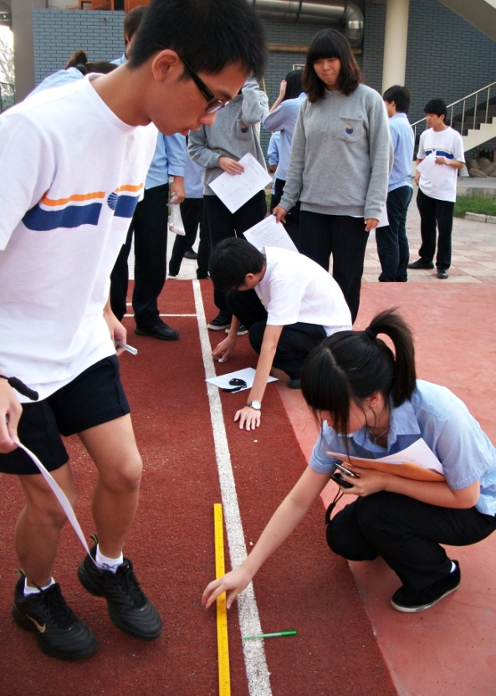
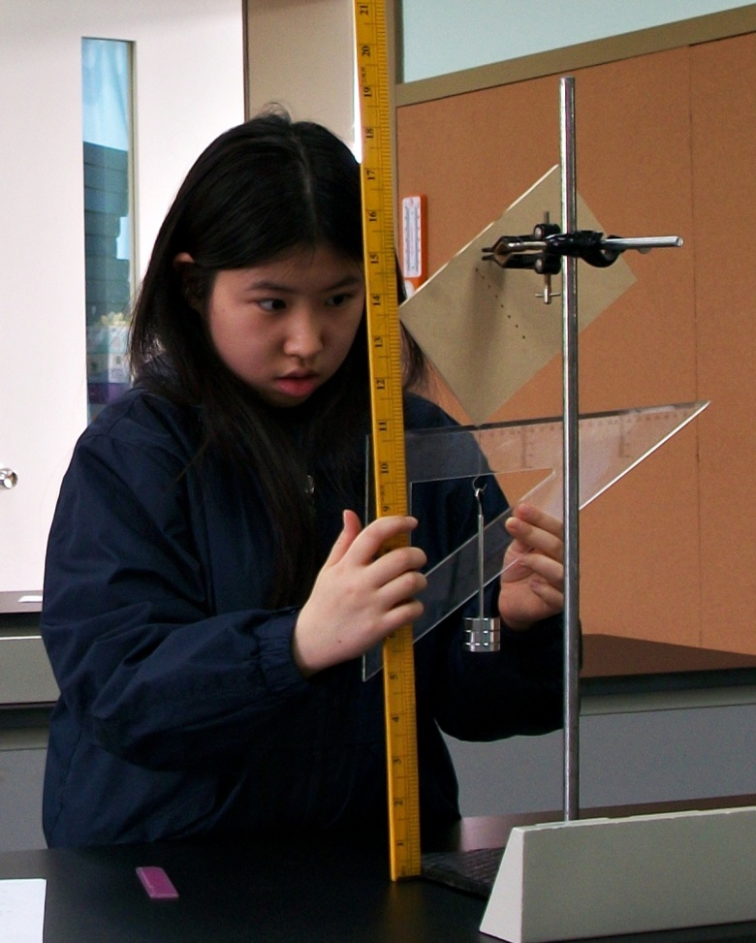
Some Tools for Measurement
When we measure, we use a measuring tool to compare some dimension of an object to a standard.
height
meter rule
LENGTH
distance

Slide 4
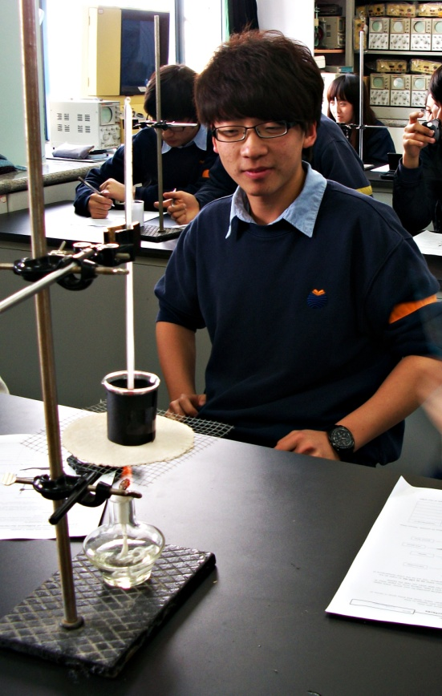
Some Tools for Measurement
thermometer
temperature
stopwatch
time

Slide 5
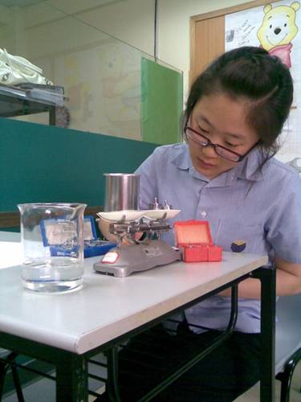
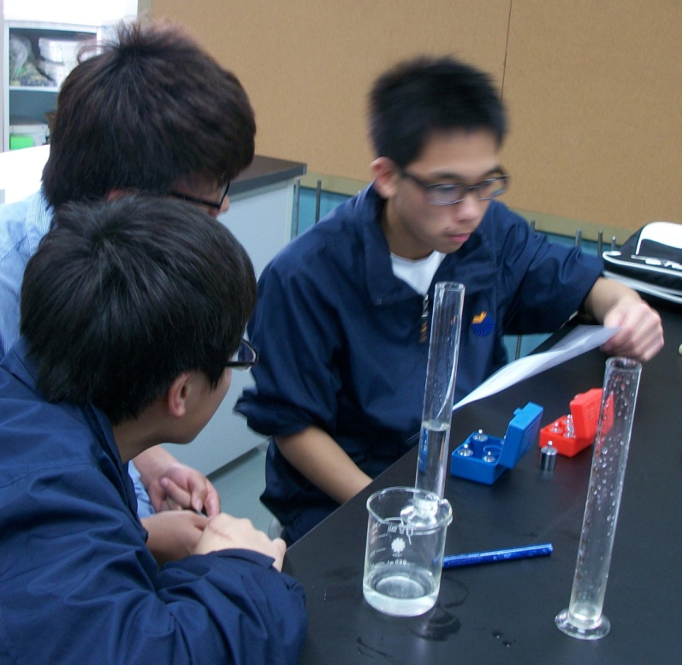
Some Tools for Measurement
balance
mass
measuring cylinder
volume

Slide 6
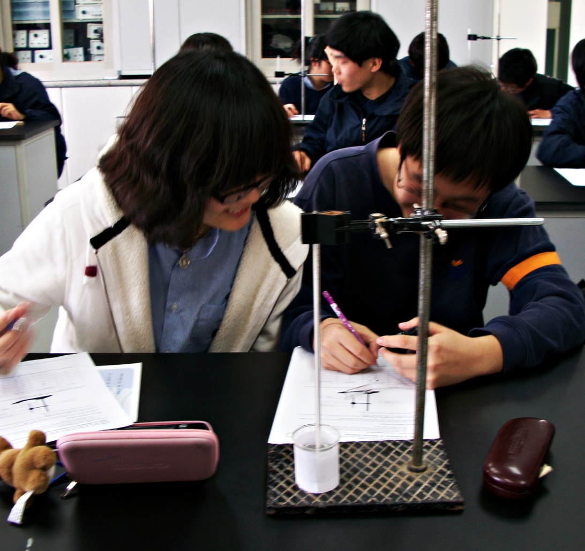
Stating a Measurement
Number + unit
a.k.a magnitude

Slide 7
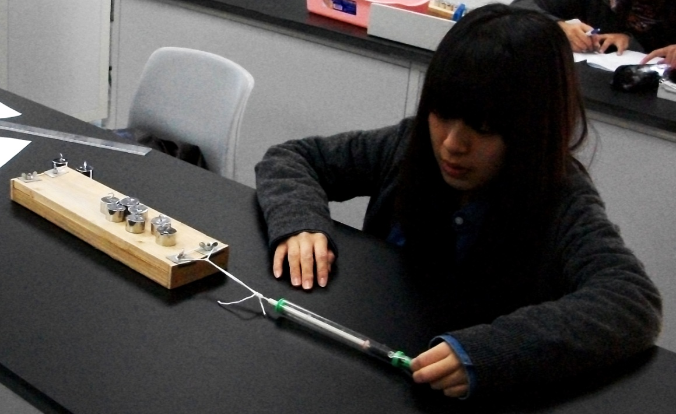
Learning Check
What are some units used to measure each of the following?
Length
Mass
Time
Temperature

Slide 8
International System of Units (SI)
Base quantity | Base Unit | Symbol
length | metre (m) | l
mass | kilogram (kg) | m
time | second (s) | t
current | Ampere (A) | I
temperature | Kelvin (K) | T
amount of substance | Mole (mol) | n

Slide 9
Prefixes used with SI units
Power | Prefix | Abbreviation
10⁻ ⁹ | nano | n
10⁻ ⁶ | micro | μ
10⁻ ³ | milli | m
10⁻ ² | centi | c
10⁻ ¹ | deci | d
10³ | kilo | k
10⁶ | mega | M

Slide 10
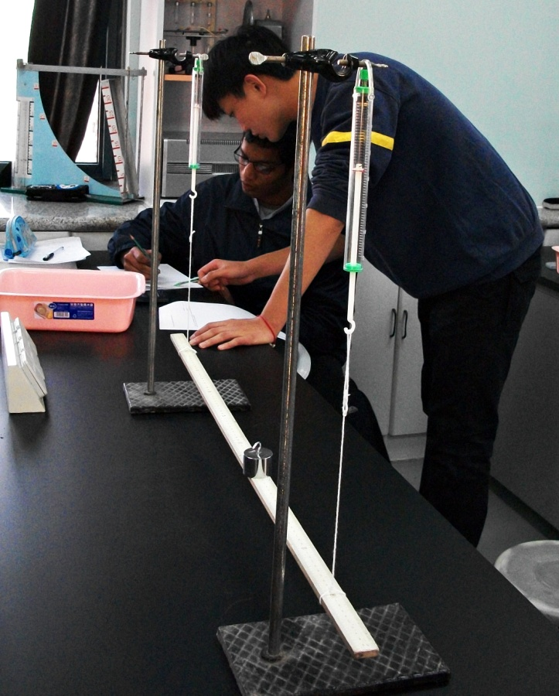
Conversion of Units
10 cm to m
150 mm to km
20 cm³ to m³
132 s to h
45 m/s to km/h
10 ms⁻² to kmh⁻²

