Slide 1
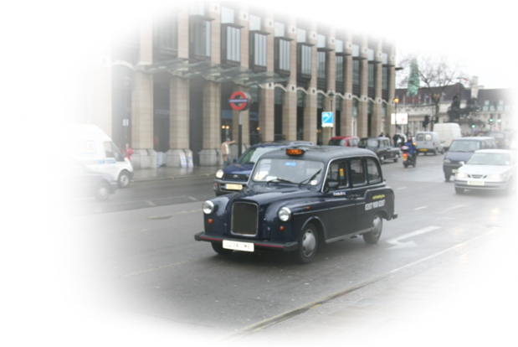
Motion
Speed and Velocity
Acceleration
Graphical Representation of Motion
Uniformly Accelerated Motion
Falling Bodies
Projectile Motion
AS Physics

Slide 2
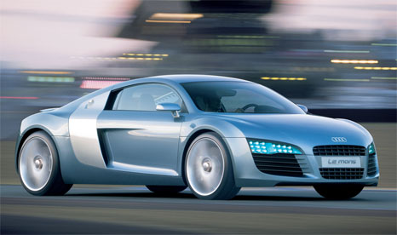
Describing Motion
Time Interval
Distance
    How far the object has traveled
Displacement
    “Distance + direction”
    Final position – initial position
2
Notes:
2

Slide 3

Describing Motion
30 m
t=0s
t=3s
x₁ =5 m
x₂ =35 m

Slide 4
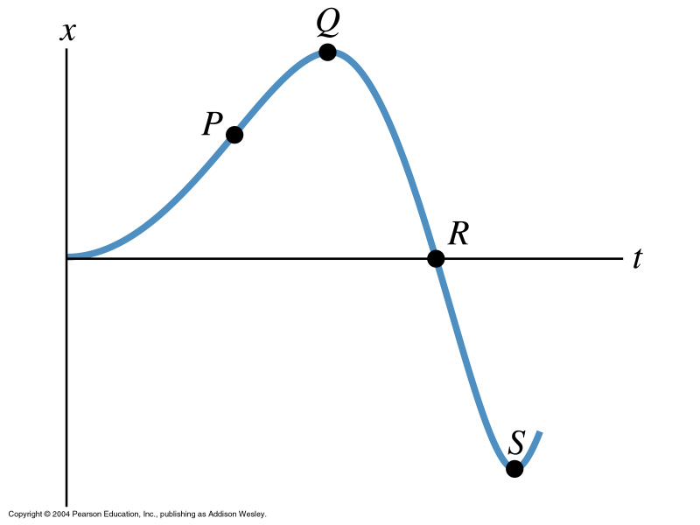
Position-Time Graph

Slide 5

Speed and Velocity
Average Speed
    Total distance traveled divided by time taken
Average Velocity
    displacement divided by time interval
Instantaneous Velocity (a.k.a. velocity)
    Rate of change of displacement at an instant
5

Slide 6
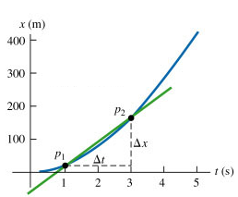
Average Velocity on a Graph
Gradient of the secant line on an s-t graph
  Change in position over time interval

Slide 7
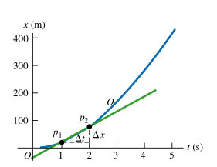
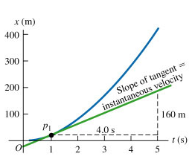
Velocity on a Graph

Slide 8
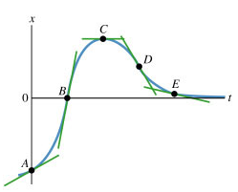
Velocity on a Graph
Gradient of a tangent on an s-t graph
  Change in position over time interval (Δt→0)
  Instantaneous velocity

Slide 9
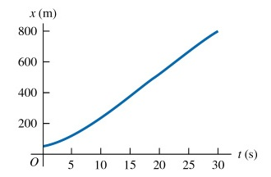
Example
Find the average velocity of the car.
Calculate the instantaneous velocity at 0 s, 5 s and 25 s.
9
Notes:
9

Slide 10
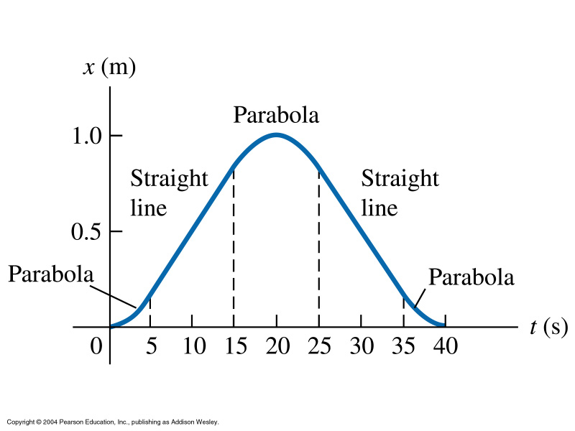
Interpreting Graphs 1

Slide 11
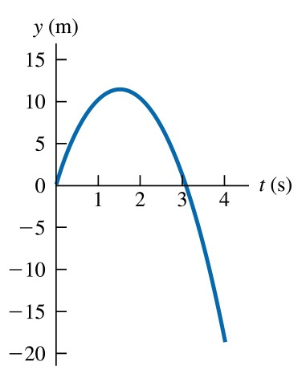
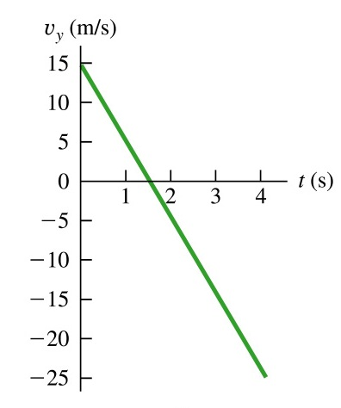
Interpreting Graphs 2

Slide 12
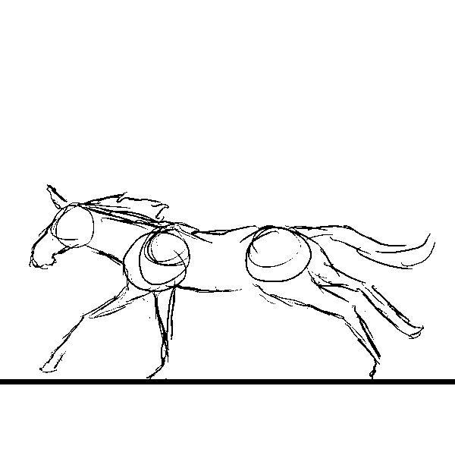
Acceleration
Rate of change of velocity
    (Final velocity – initial velocity) divided by time
Change in magnitude of velocity
    Speeding up
    Slowing down
Change in direction of velocity
Change in both magnitude and direction
12
Notes:
12

Slide 13
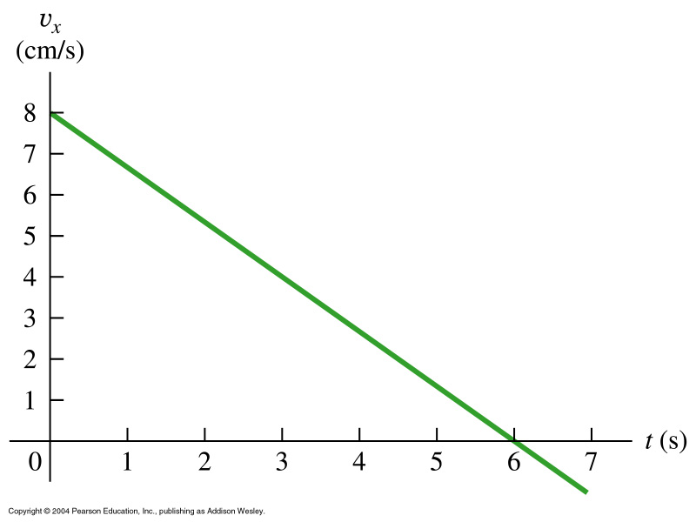
Acceleration on Graphs
Gradient of a secant line on a v-t graph
  Average acceleration
Gradient of a tangent line
  Instantaneous acceleration
Area under the graph
  displacement
13
Notes:
13

Slide 14
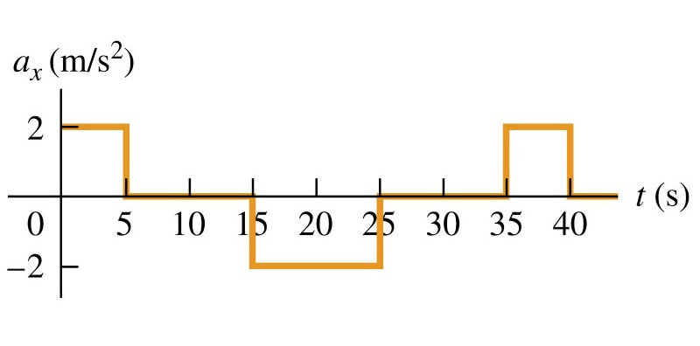
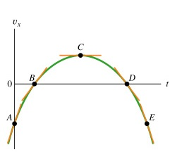
Interpreting Graphs 3

Slide 15
Uniformly Accelerated Motion
Equations
u = initial velocity
v = final velocity
a = constant acceleration
t = time taken from start
s = displacement
15
Notes:
15

Slide 16
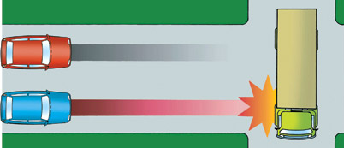
Uniformly Accelerated Motion
Car Stopping Distances
  Thinking distance
    Car travels at constant speed
  Braking Distance
    Car decelerates
  Stopping Distance
    Thinking Distance + Braking Distance
16
Notes:
16

Slide 17
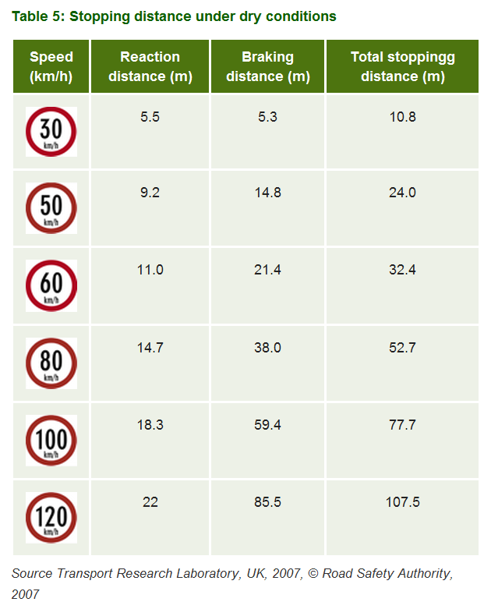
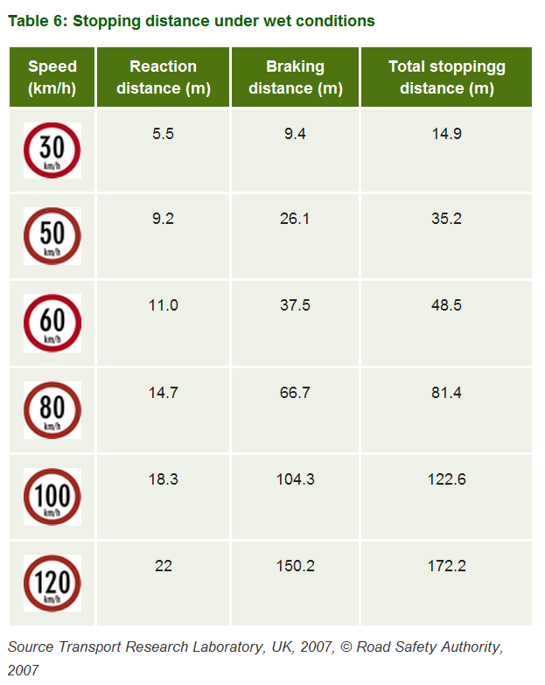
Car Stopping Distance
17
Notes:
17

Slide 18

Car Stopping Distance
18
Notes:
18

Slide 19
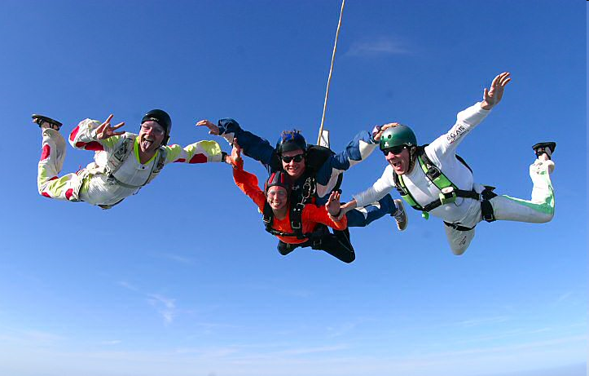

Falling Bodies
Free Fall
  Negligible air resistance
  Constant downwards acceleration
  9.81 ms⁻²
  Equations
Air Resistance
  Proportional to surface area
  Proportional to speed
  Terminal velocity

Slide 20
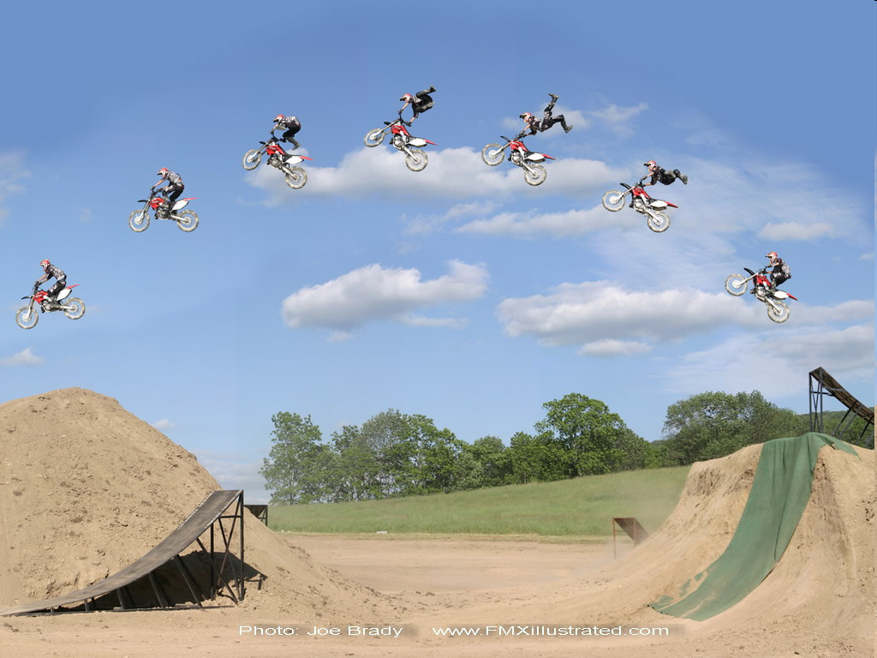
Projectile Motion
Horizontal Motion
  Constant velocity
  Equation
Vertical Motion
  Free Fall
  Constant acceleration
  Acceleration due to gravity
  Equations
Examples

