Slide 1
Forces
Seeing forces
Forces big and small
Weight – the pull of gravity
Friction – an important force
Air resistance
Patterns of falling
End of Unit questions

Slide 2
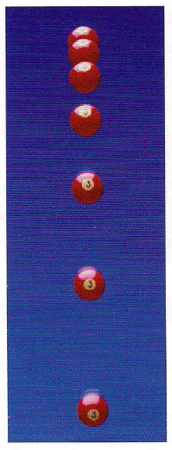
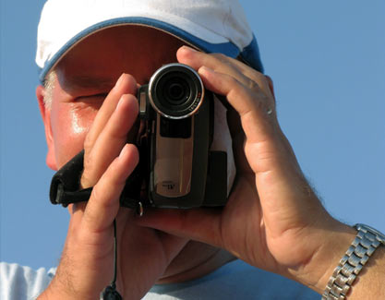
Patterns of Falling
Too fast!

Slide 3
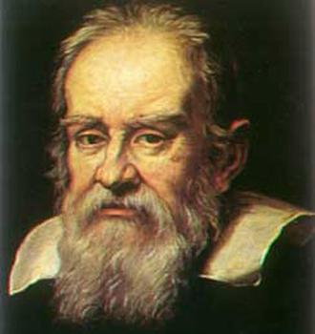
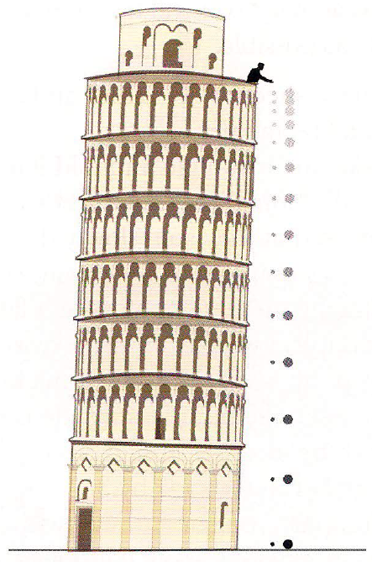
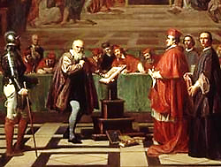
Galileo
Big ball will land first
Both balls landed at the same time

Slide 4
