Slide 1
Refraction
Inquiry-based Lecture

Slide 2
Inquiry 1
Put the pencil in an empty beaker and see it on the side of the beaker.
What do you see?
Now fill the beaker with water until you cover half of the beaker. See the pencil on the side of the beaker.
What do you see?

Slide 3
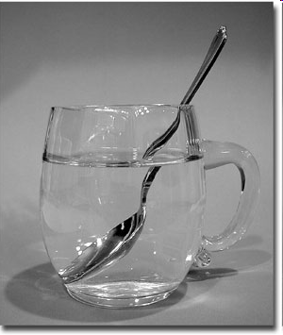
Refraction
Bending of waves when it passes from one medium to another
Waves bend because their speeds change when they move from one medium to another

Slide 4
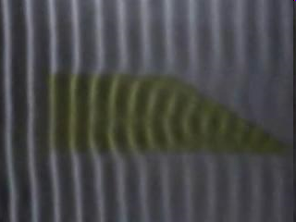
Water waves change speed when they move from deep to shallow part

Slide 5
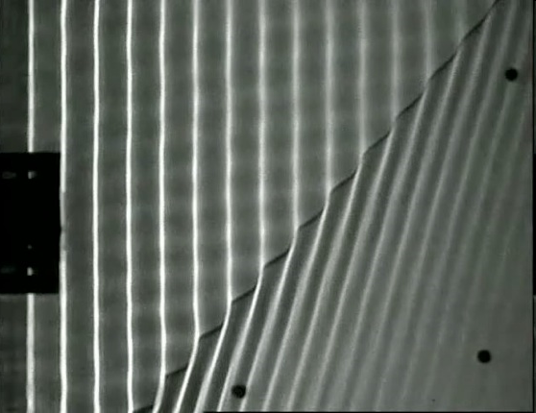

Slide 6
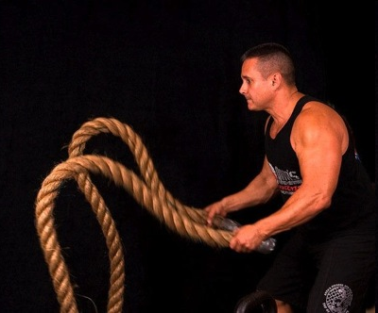
Transverse waves on a rope slow down as they move from thinner rope to thicker rope

Slide 7
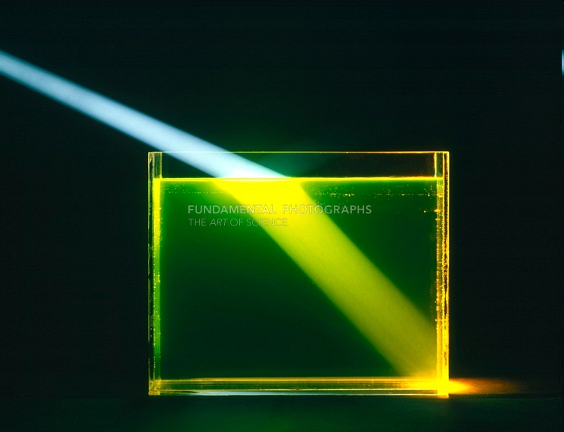
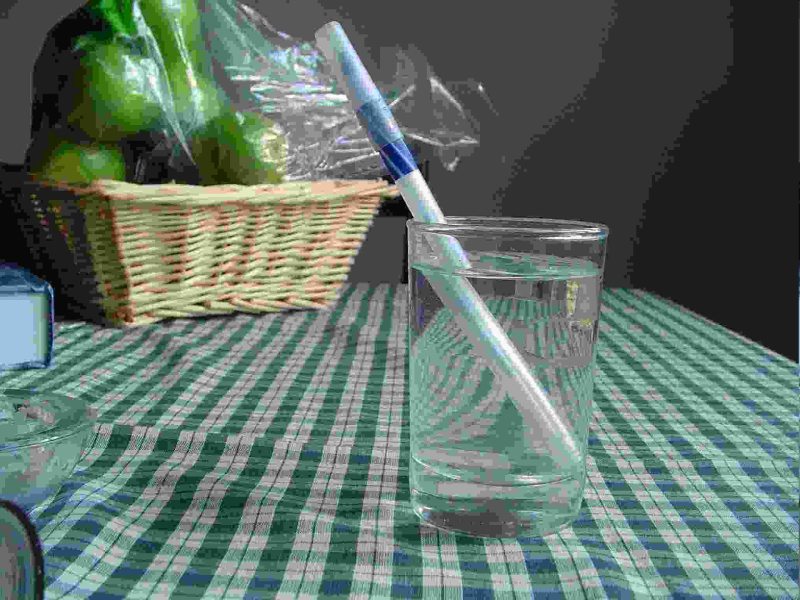
Refraction
Objects look bent because light is refracted as it moves from air to water

Slide 8
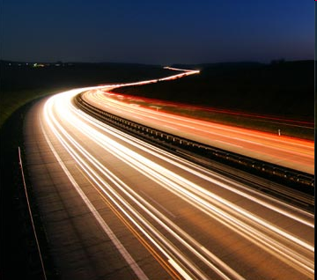
Remember
Sound moves fastest in solids, then liquids, then gases and no sound at all in vacuum
But light moves fastest in vacuum, then gases, then liquids, then solids

Slide 9
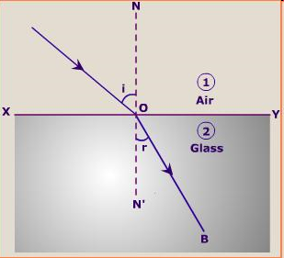
Inquiry 2
Let’s do the glass bar, pins and paper experiment.
Normal line
Incident angle
Refracted angle

Slide 10
Remember
If light slows down from one medium to another, the light ray is bent closer to the normal.
The angle of incidence is greater than the angle of refraction
Example: air to glass, air to water

Slide 11
Remember
If light speeds up from one medium to another, the light ray is bent away from the normal.
The angle of incidence is smaller than the angle of refraction
Example: glass to air, water to air

Slide 12
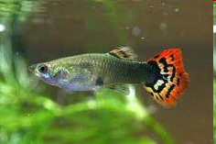
What and how you see things around you are different from what the fish sees.

Slide 13
A fisheye’s view of the world

Slide 14
A fisheye’s view of the world

Slide 15
Remember
If light enters in a parallel-sided block, then it leaves the block at the same angle as it enters the block but bent sideways.

Slide 16
Inquiry 3
Put a coin in an empty beaker.
Move in such a way that you don’t see the coin in the beaker anymore.
Ask your friend to slowly pour water in the beaker.
What happens?

Slide 17
Refraction
Causes things to look shallower than they actually are
Apparent depth
Put a ruler in the beaker of water and read from the top. Does it look longer or shorter?
What happens to the distance between divisions on the ruler?
Are they closer or farther?

Slide 18
Refraction
Measure the depth of the water from the top.
Measure it again by putting the ruler on the side of the beaker.
Are they the same or not?

Slide 19
Going Beyond
What are everyday examples of refraction?
What is a prism and why does it form rainbows?
How is a rainbow formed?

Slide 20
Prism
A transparent optical element with flat polished surfaces that refract light.
Can be used to break light up to its spectral colors
Colors of the rainbow
Can also be used to reflect light

Slide 21
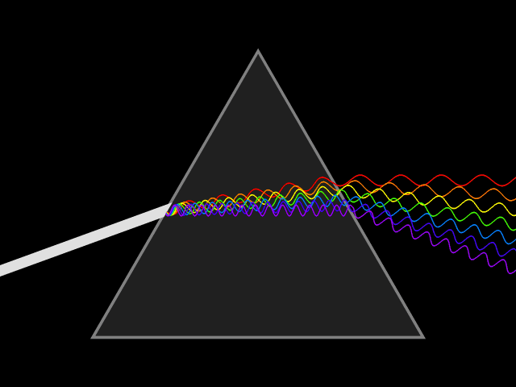
Prism
Materials refract different wavelengths of light at different angles
Dispersion
ROY G BIV

Slide 22
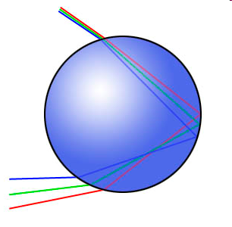
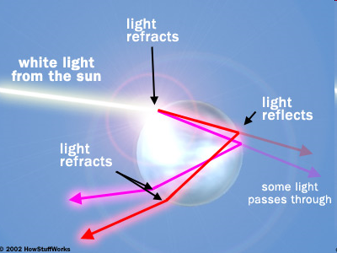
Rainbow

Slide 23
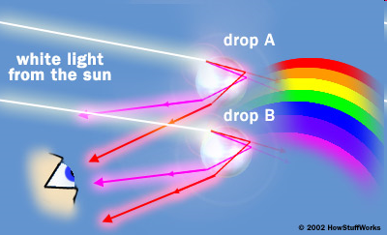
Rainbow

Slide 24
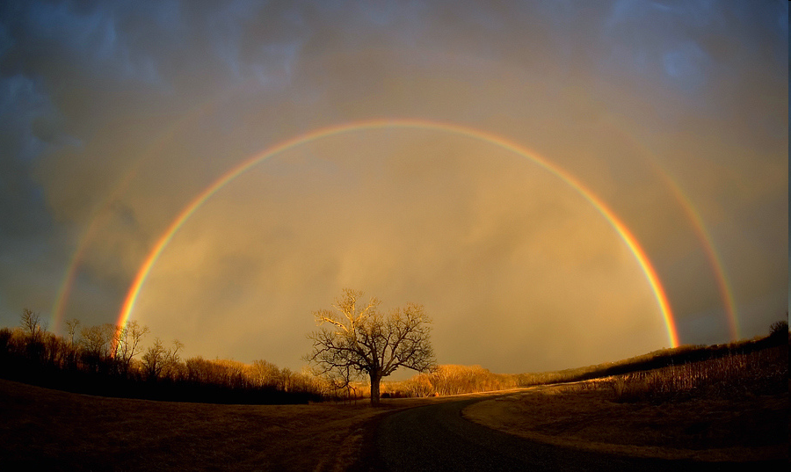
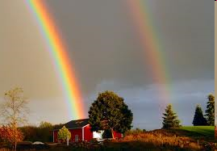
Rainbow

Slide 25
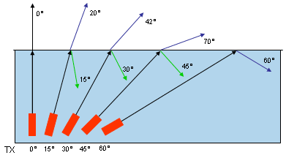
In transparent materials, some light are reflected

Slide 26
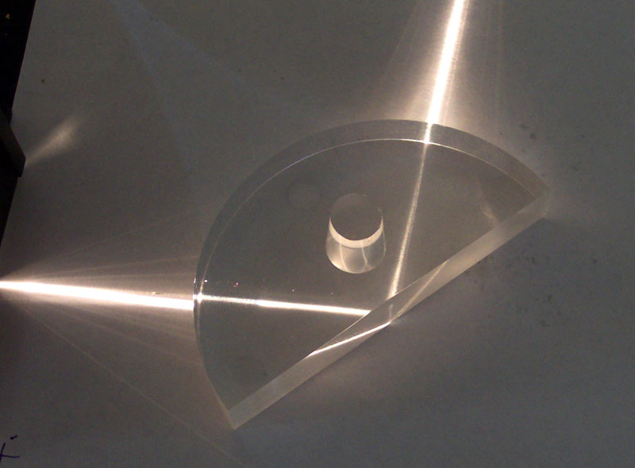
Total Internal Reflection (TIR)
When a ray does not cross the boundary but is reflected instead

Slide 27
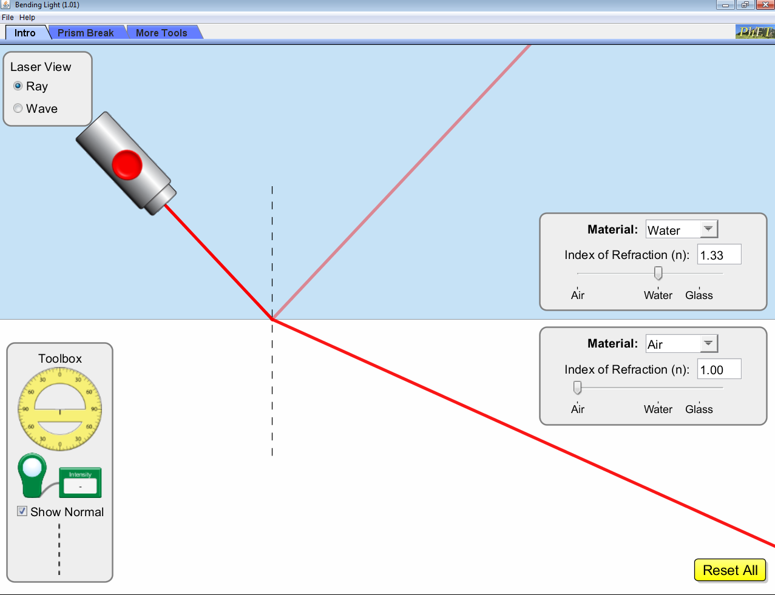
Critical Angle
Angle at which total internal reflection occurs

Slide 28
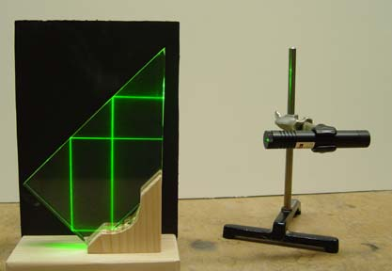

Slide 29
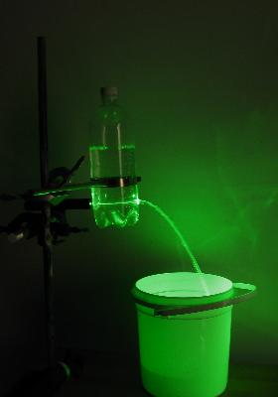
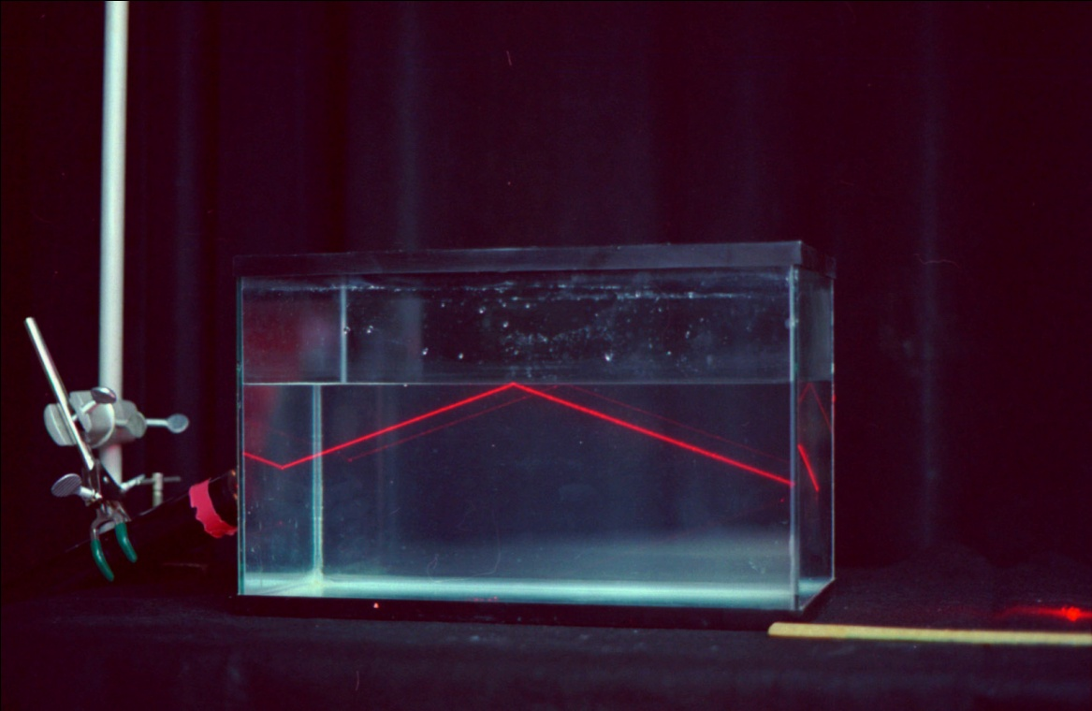

Slide 30
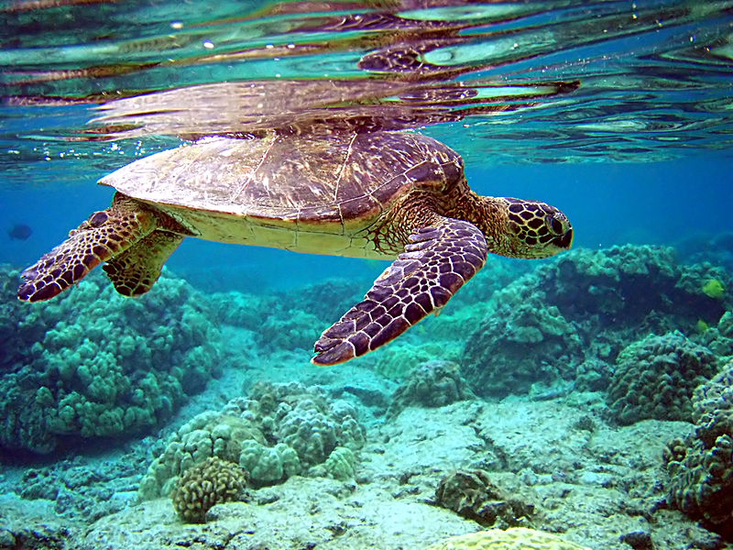

Slide 31
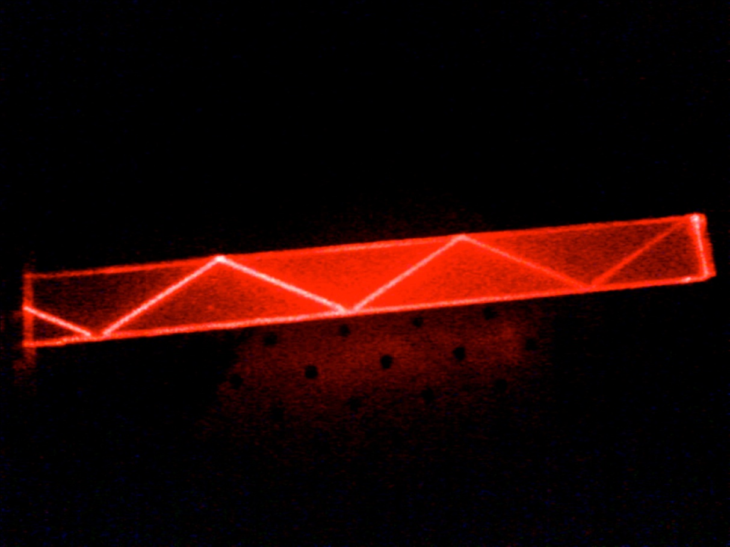
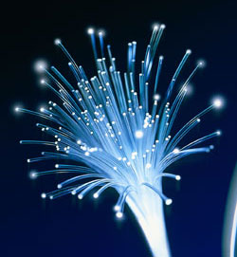
Fibre Optics

Slide 32
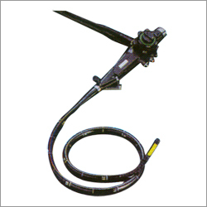
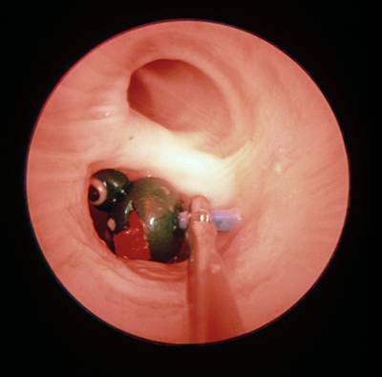
Endoscope

