Slide 1
Forces
Seeing forces
Forces big and small
Weight – the pull of gravity
Friction – an important force
Air resistance
Patterns of falling
End of Unit questions

Slide 2


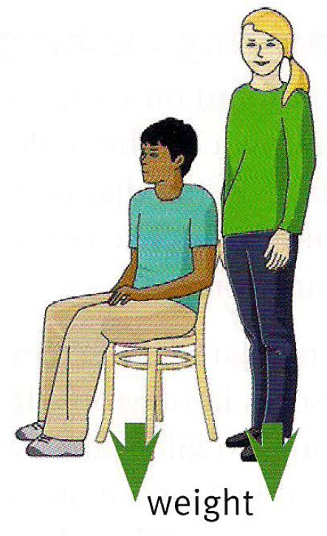
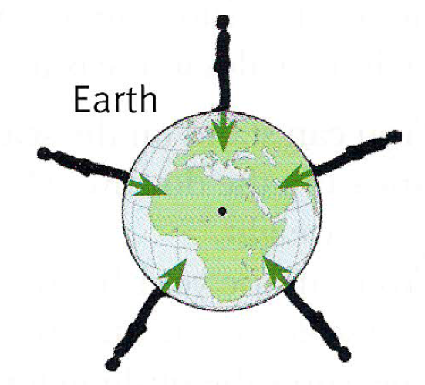

Weight the pull of gravity

Slide 3

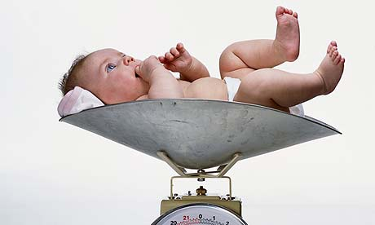
Weight the pull of gravity
weight
gravity

Slide 4
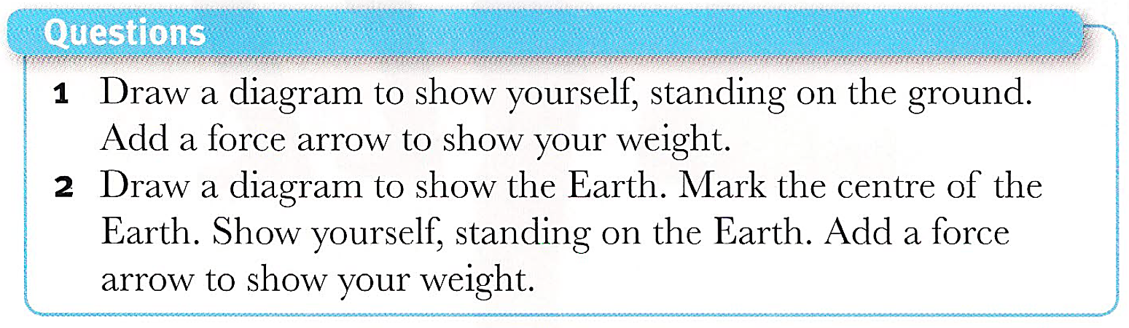




Weight
Contact force

Slide 5
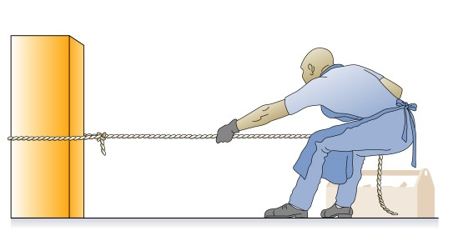
Weight
Weight
Contact force
Contact forces

Slide 6


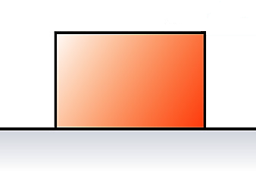

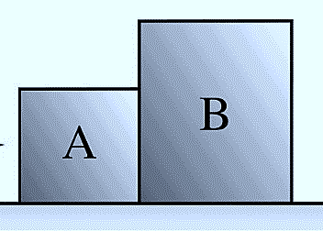
Draw force arrows for weight and contact forces on each of picture.

Slide 7



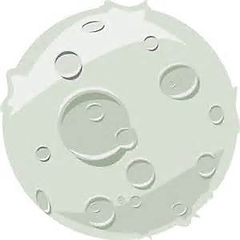
60 kg = 600 N
60 kg = 300 N

Slide 8
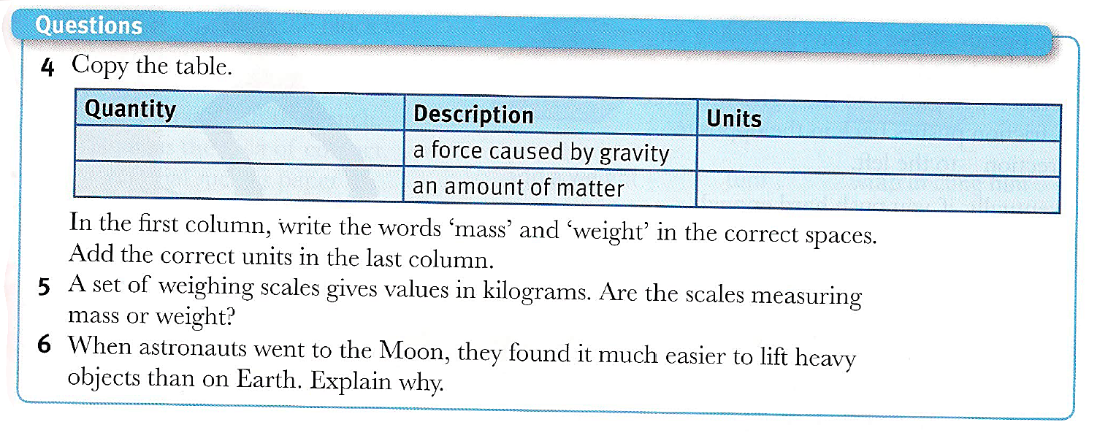

Slide 9
